Slide 1
4.3.1 Graph-Traversal
Syllabus Details
4.3.1 Graph-traversal
4.3.1.1 Simple graph-traversal algorithms
4.3.1 Graph-Traversal
Starter
Join the term to the definition.
What is the difference between the directed graph and undirected graph?
What is a graph?
Adjacency matrix and adjacency list
A graph is a collection of two sets: vertices and edges. Two adjacent vertices or nodes are connected by edges or arcs.
Two-dimensional array
What data structure is used to implement an unweighted graph using adjacency list?
The adjacency matrix of an unweighted graph is symmetric with respect to its diagonal.
What data structures are used to implement a weighted graph using adjacency list?
It is not preferred for a sparsely connected graph because many cells are left blank. This leads to wastage of memory space. Also, it isn’t easy to modify nodes in a two-dimensional array.
State disadvantages of implementing a graph using adjacency matrix.
In directed graphs, all the edges are unidirectional. In undirected graphs, all the edges are bidirectional.
List of nodes is created. A dictionary is used to represent edges of a weighted graph.
State properties of the adjacency matrix of an undirected graph.
What data structure is used to implement graphs using adjacency matrix?
List of nodes is created. Each node is linked to a list of nodes it is attached to.
In what ways are graphs implemented in programs?

Slide 2
Key concept
Graph traversal
Graph traversal means to visit its vertices in some sequence.
Task one - Operations on a graph
There are a number operations that can be performed on a graph.
Complete the table.
Operation | Description
Adjacent | returns whether there is an edge between vertices
Neighbours | returns all the vertices between two vertices
Add | adds a new vertex from the graph
Remove | removes a vertex from the graph
Add edge
Remove edge
Get vertex value
Set vertex value
Get edge value
Set edge value

Slide 3
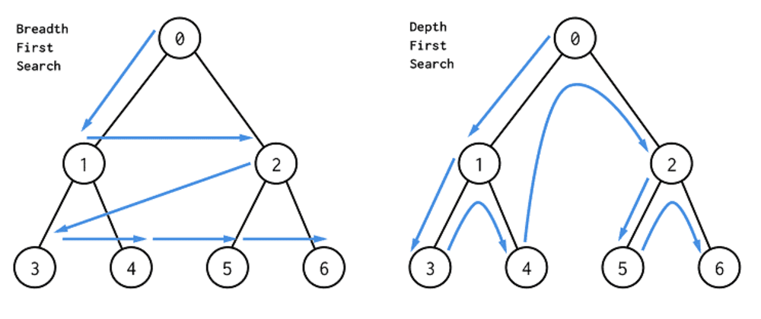
Key concept
Breadth-first search (BFS)
Traverses the graph, starting at the root node, visiting each neighbouring node before moving to the vertices at the next depth.
Breadth- first search on a graph
The breadth-first search is used to determine the shortest path between vertices on a graph, search engine indexing using a crawler algorithm, finding devices on peer-to-peer networks and broadcasting frames or packets on a network. GPS navigation systems, memory management using Cheney’s algorithm and finding nearby people on a social network are all applications of breadth-first searches.
BFS in simple-structured English
Set the root vertex as the current vertex.
If the vertex has an edge that has not been visited:
  Enqueue the linked vertex.
  Repeat from step 2 until all the edges has been visited.
Add the current vertex to the list of visited vertices.
Dequeue the queue and set the item removed as the current vertex.
Repeat from step 2 until there are no vertices to visit.
Output all the visited vertices.
The graph on the left shows the order the nodes would be visited using the BFS traversal.

Slide 4
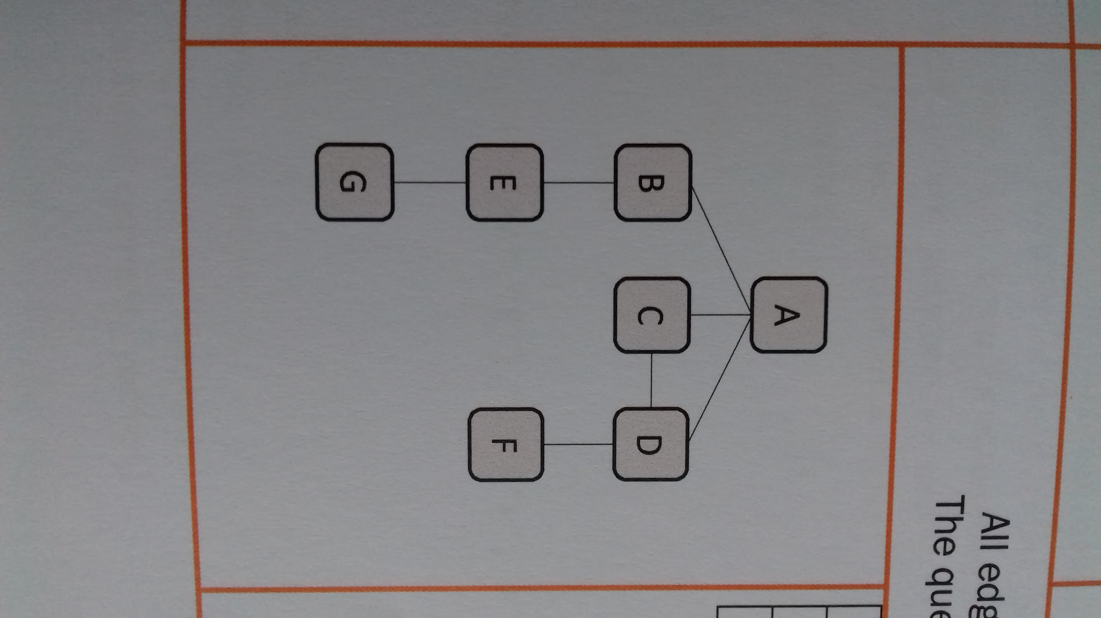
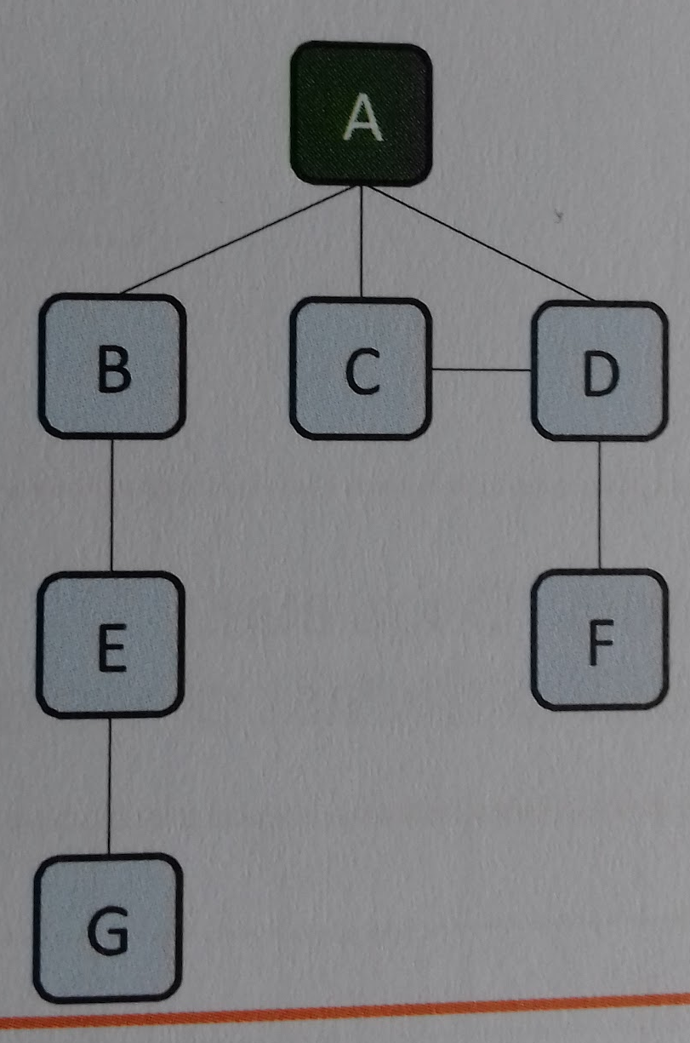
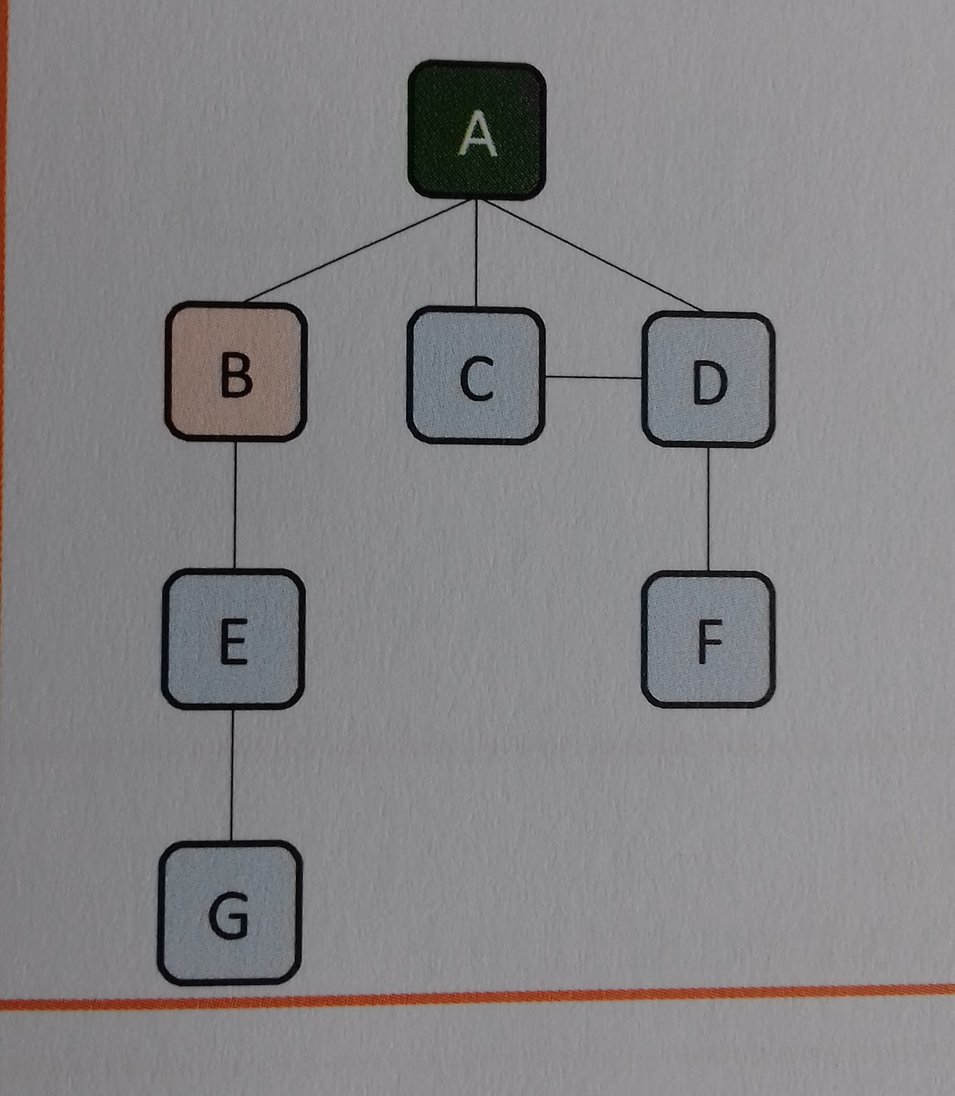
Example one - worked example
 | Graph | Queue | Visited
Step 1 | Start at a root vertex. Add A to the list of the visited vertices.
 |  |  | A
 | Graph | Queue | Visited
Step 2 | Enqueue B
 |  |  | A
f
b
B

Slide 5
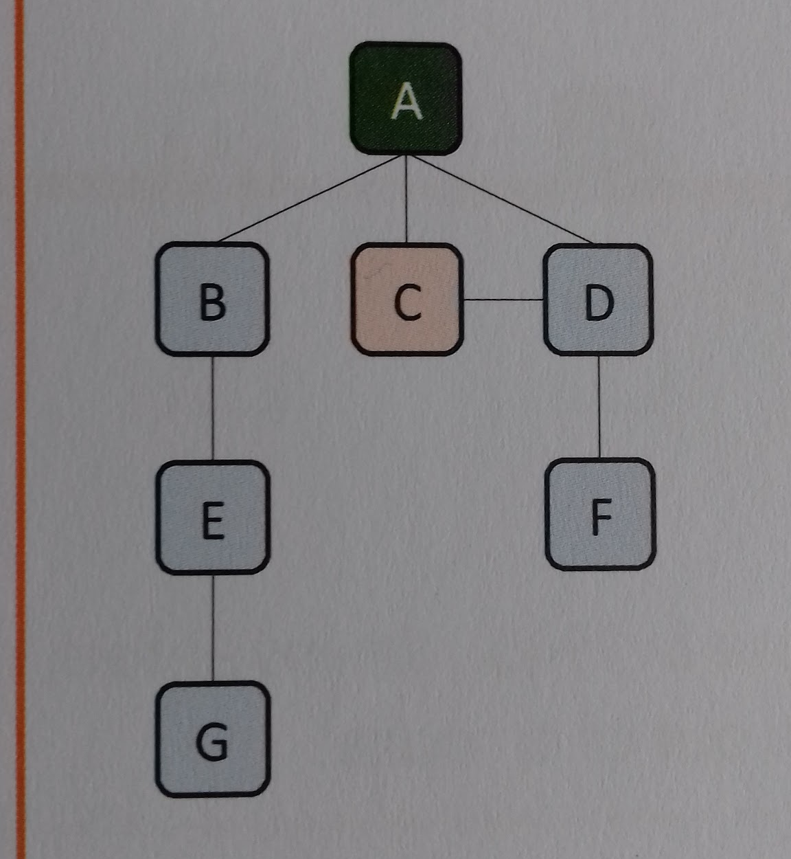
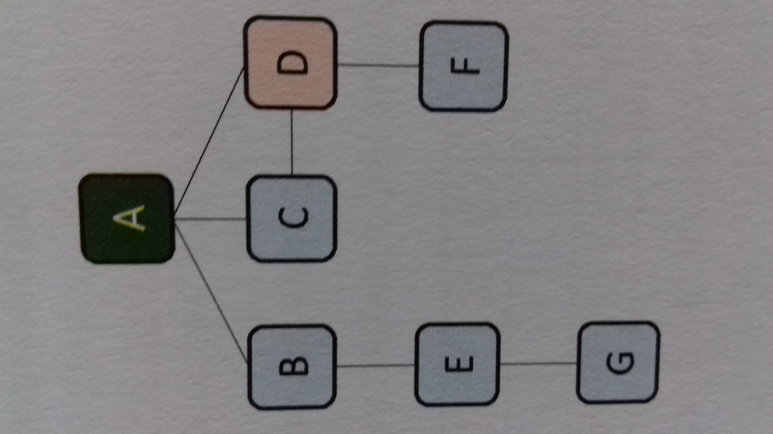
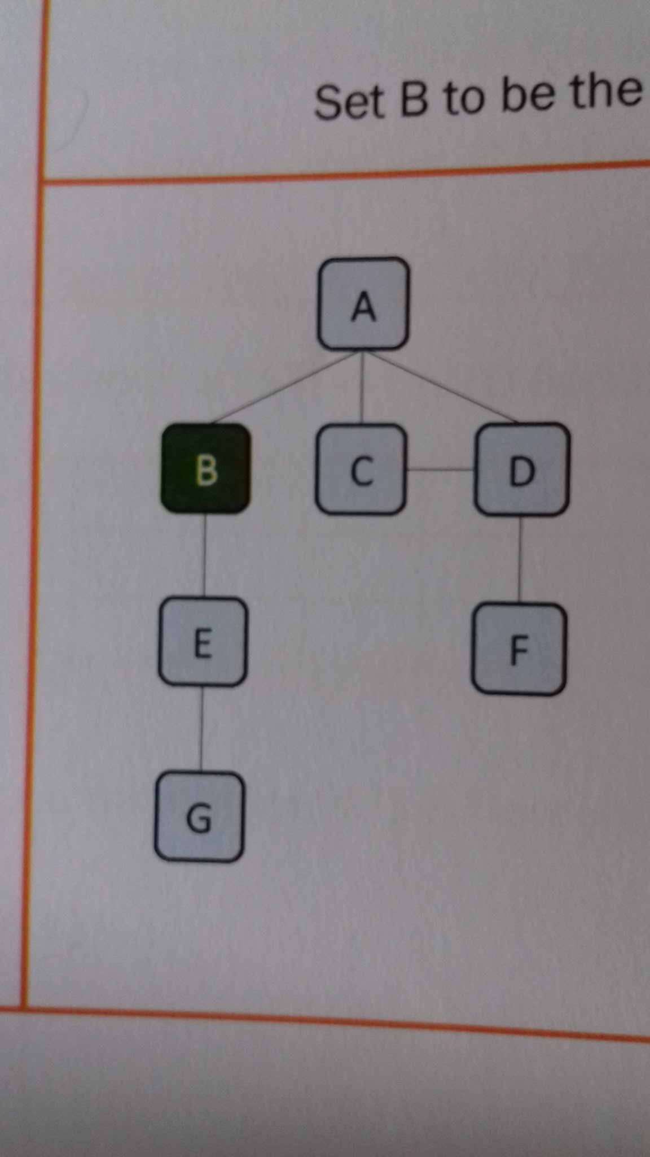
Example one - worked example
 | Graph | Queue | Visited
Step 3 | Enqueue C
 |  |  | A
f
 | b
B | C
 | Graph | Queue | Visited
Step 4 | Enqueue D
 |  |  | A
f
 |  | b
B | C | D
 | Graph | Queue | Visited
Step 5 | All edges considered. Dequeue. Set B to be the current vertex. Add B to the list of visited vertices.
 |  |  | AB
 | f
 |  | b
B | C | D

Slide 6
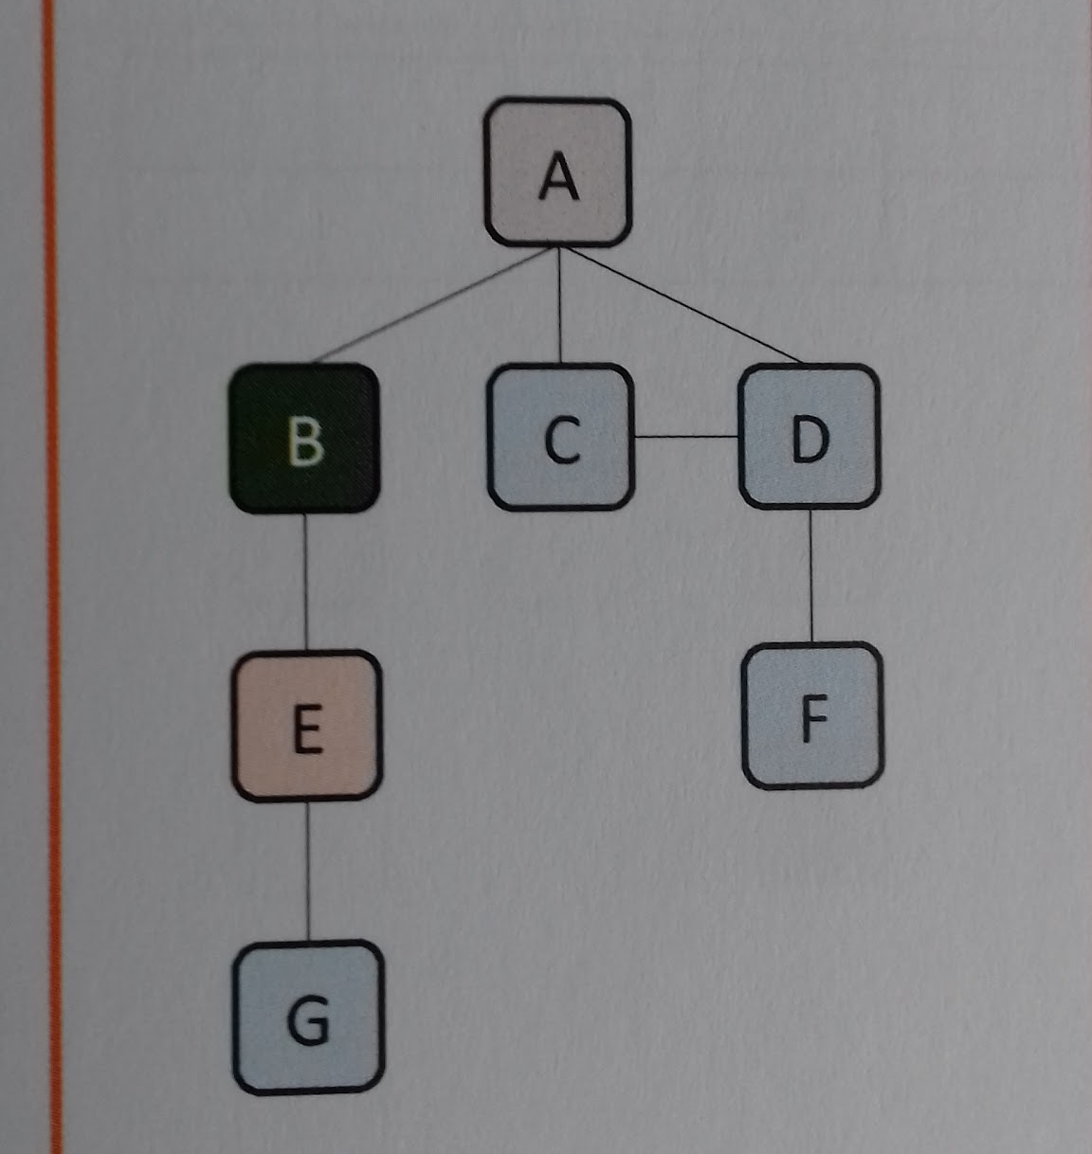
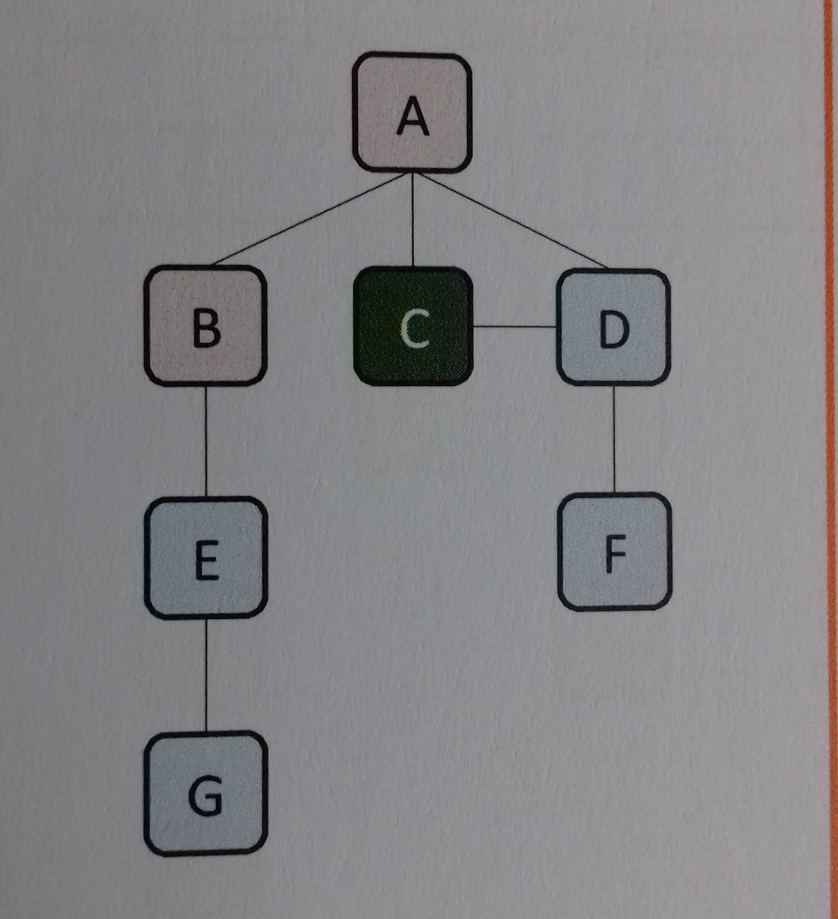
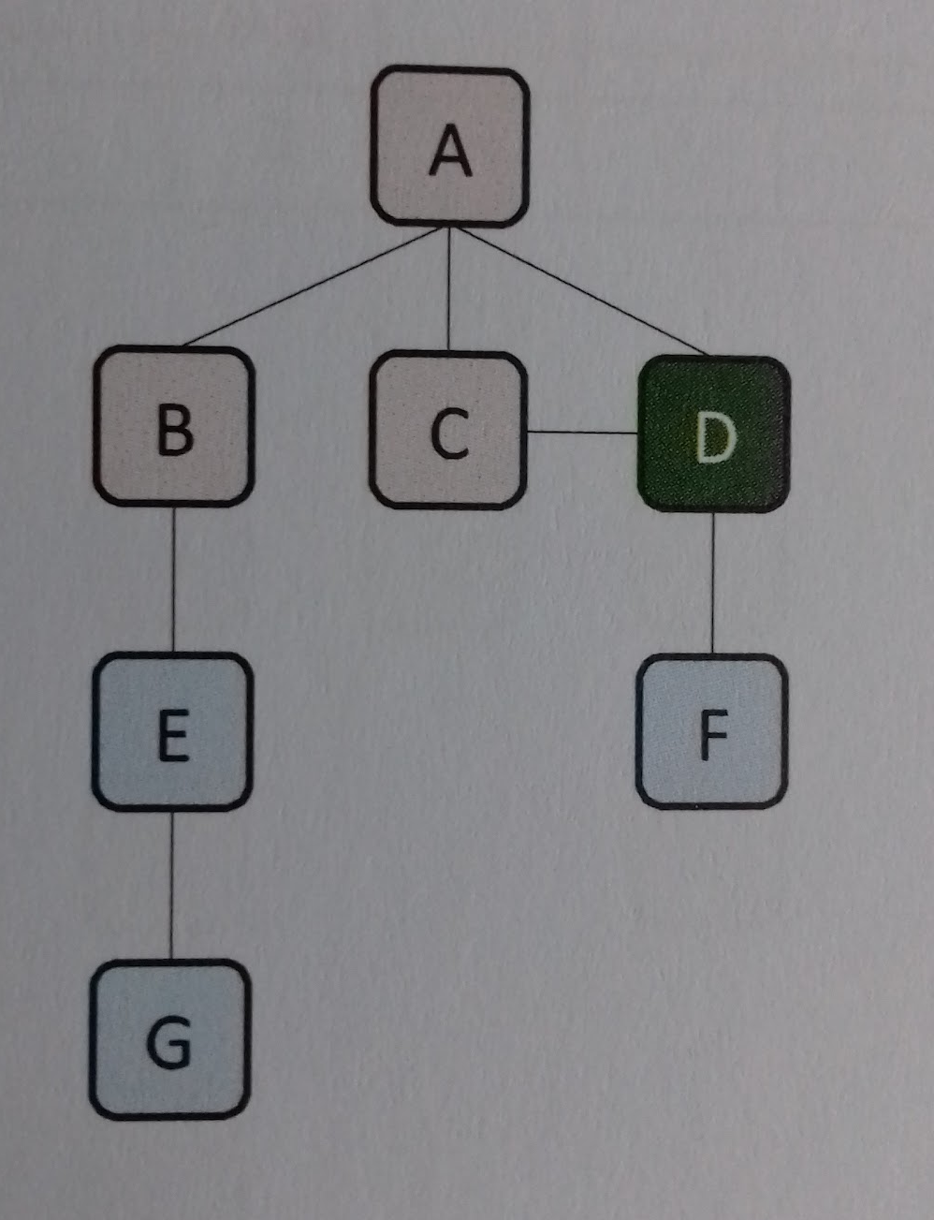
Example one - worked example
 | Graph | Queue | Visited
Step 6 | Enqueue E
 |  |  | AB
 | f
 |  |  | b
B | C | D | E
 | Graph | Queue | Visited
Step 7 | All edges considered. Dequeue. Set C to be the current vertex. Add C to the list of visited vertices.
 |  |  | ABC
 |  | f
 |  |  | b
B | C | D | E
 | Graph | Queue | Visited
Step 8 | All edges considered. Dequeue. Set D to be the current vertex. Add D to the list of visited vertices.
 |  |  | ABCD
 |  |  | f
 |  |  | b
B | C | D | E

Slide 7
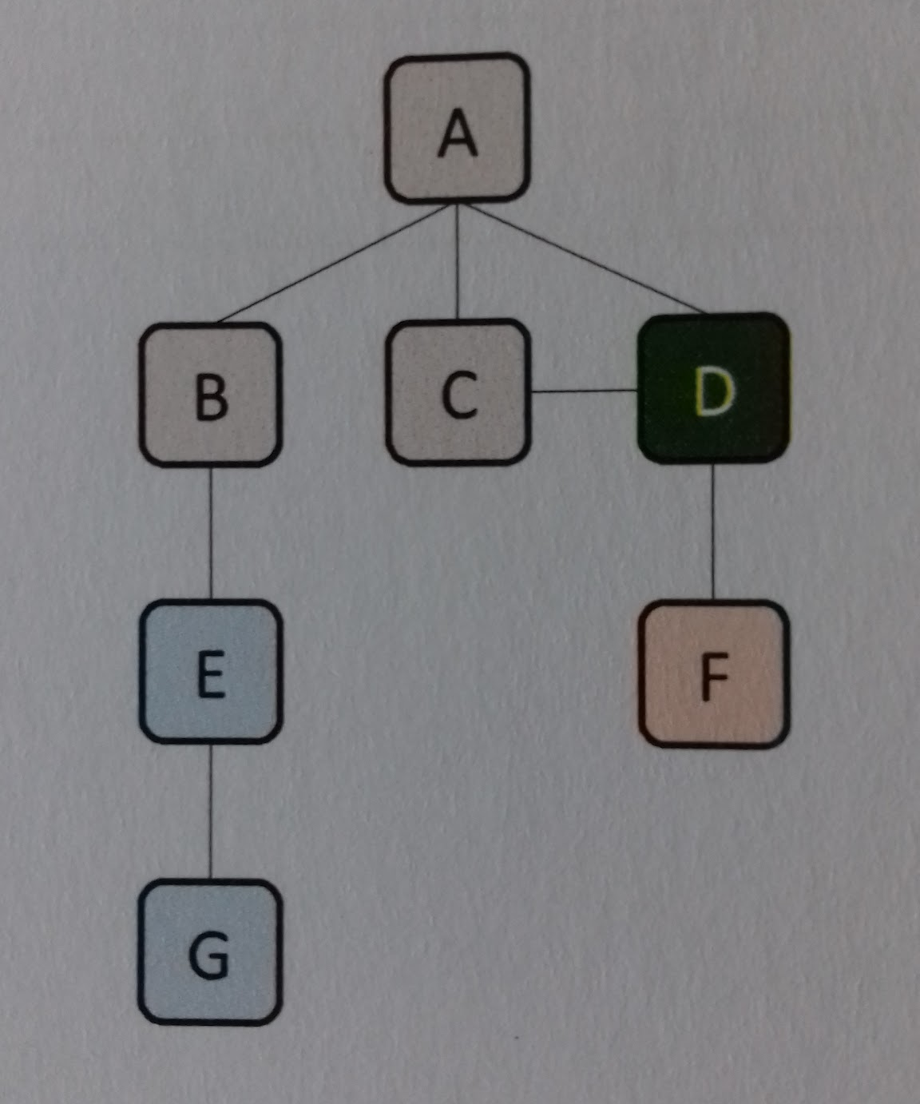
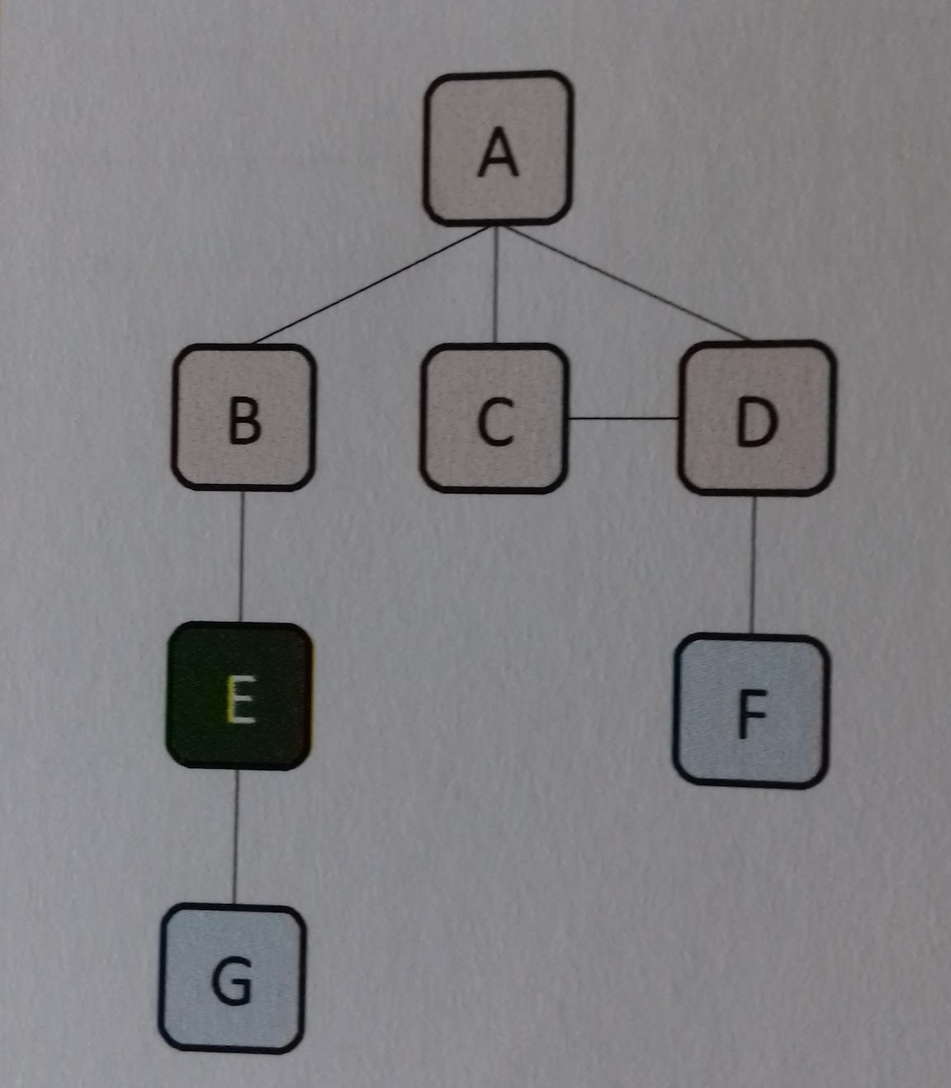
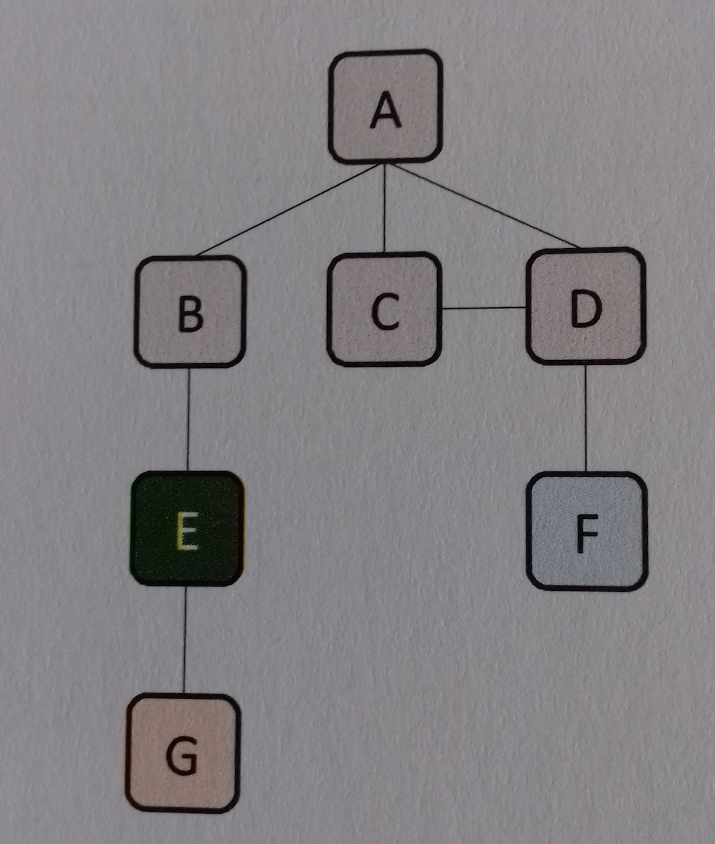
Example one - worked example
 | Graph | Queue | Visited
Step 9 | Enqueue F
 |  |  | ABCD
 |  |  | f
 |  |  |  | b
B | C | D | E | F
 | Graph | Queue | Visited
Step 10 | All edges considered. Dequeue. Set E to be the current vertex. Add E to the list of visited vertices.
 |  |  | ABCDE
 |  |  |  | f
 |  |  |  | b
B | C | D | E | F
 | Graph | Queue | Visited
Step 11 | Enqueue G
 |  |  | ABCDE
 |  |  |  | f
 |  |  |  |  | b
B | C | D | E | F | G

Slide 8
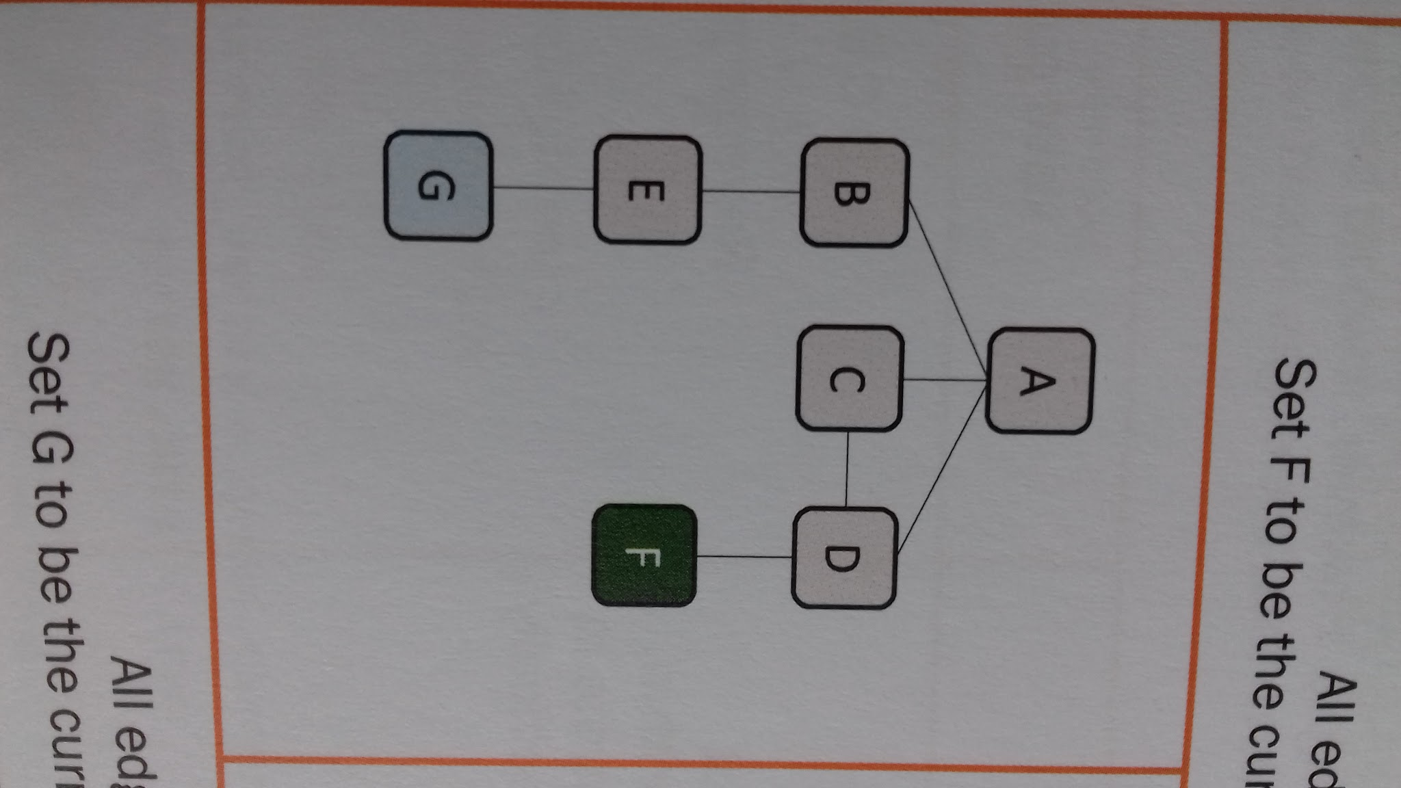
Example one - worked example
 | Graph | Queue | Visited
Step 12 | All edges considered. Dequeue. Set F to be the current vertex. Add F to the list of visited vertices.
 |  |  | ABCDEF
 |  |  |  |  | f
 |  |  |  |  | b
B | C | D | E | F | G
 | Graph | Queue | Visited
Step 13 | All edges considered. Dequeue. Set G to be the current vertex. Add G to the list of visited vertices.
 |  |  | ABCDEFG
 |  |  |  |  |  | f
 |  |  |  |  | b
B | C | D | E | F | G
 | Graph | Queue | Visited
Step 14 | All edges visited considered. Dequeue. The queue is empty. Algorithm complete.
 |  |  | ABCDEFG
 |  |  |  |  |  | f
 |  |  |  |  | b
B | C | D | E | F | G

Slide 9
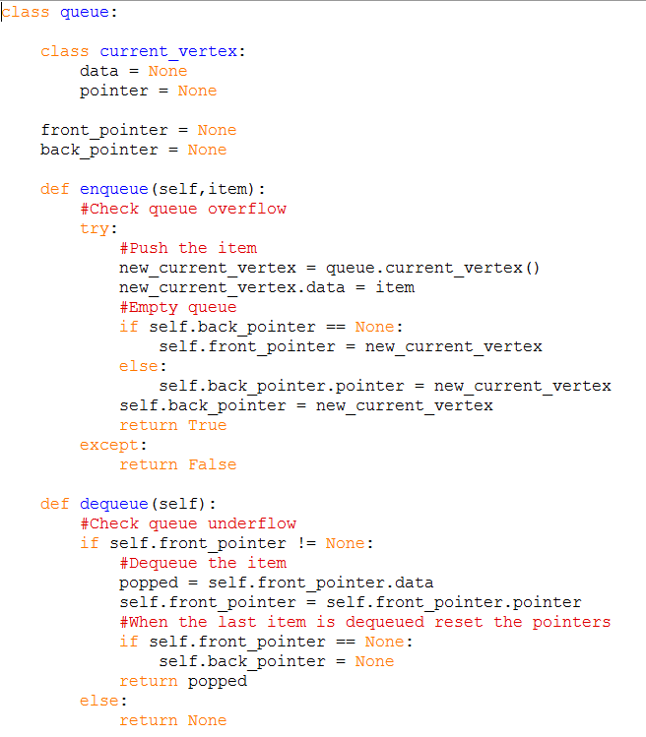
Example one - worked example
It is worth noting that there is more than one valid output from a breadth-first search. This implementation examined the edges from A in the order B,C,D, from left to right. However , it would be perfectly valid to examine them in reverse order too, from right to left. To achieve this , the edges would need to be enqueued in reverse order.
Valid output 1
ABCDEFG
Valid output 2
ADCBFEG -Reversal traversal
Code used

Slide 10
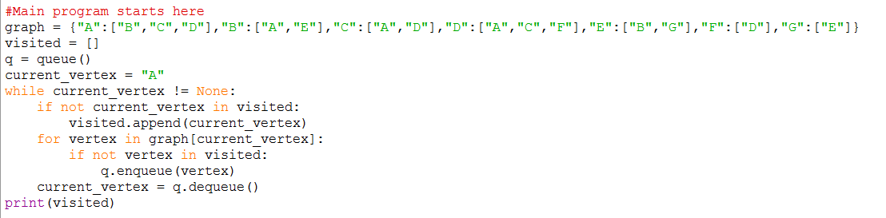

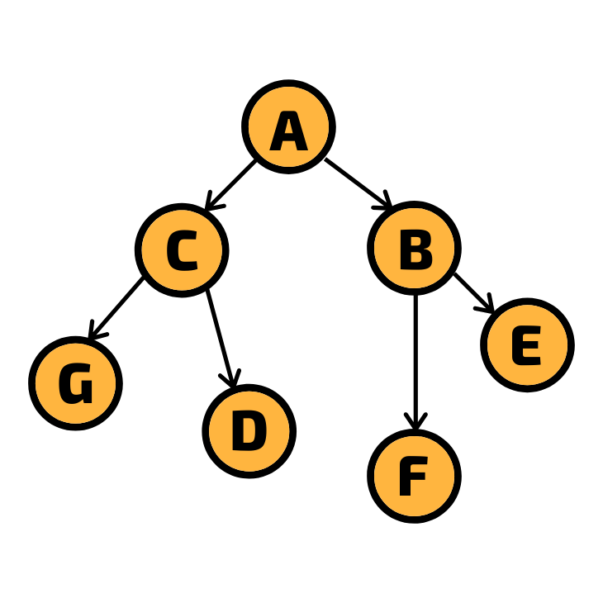
Code used
Notes
Practical
Alter the code given to you so that it can search the graph shown below. Write the visited list in the box below.
Answer box

Slide 11
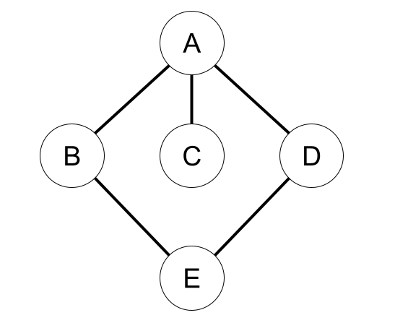
Example two
 | Graph | Queue | Visited
Step 1 | Start at a root vertex. Add A to the list of the visited vertices.
 |  |  | A
 | Graph | Queue | Visited
Step 2 | Enqueue B
 |  |  | A
B

Slide 12
Example two
 | Graph | Queue | Visited
Step 3 | Enqueue C
 |  |  | A
B | C
 | Graph | Queue | Visited
Step 4 | Enqueue D
 |  |  | A
B | C | D
 | Graph | Queue | Visited
Step 5
 |  |  | A B
 | C | D

Slide 13
Example two
 | Graph | Queue | Visited
Step 6 | Enqueue E
 |  |  | A B
 | C | D | E
 | Graph | Queue | Visited
Step 7 | Visit C
 |  |  | A B C
 |  | D | E
 | Graph | Queue | Visited
Step 8 | Visit D
 |  |  | A B C D
 |  |  | E

Slide 14
Example two
 | Graph | Queue | Visited
Step 9 | Visit E
 |  |  | A B C D E
 | Graph | Queue | Visited
Step 10
 |  |  | A B C D E
 | Graph | Queue | Visited
Step 11

Slide 15
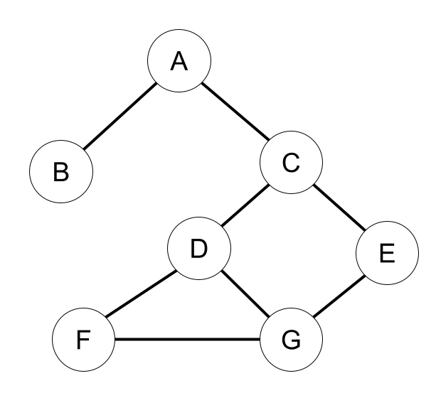
Questions
Hand trace the breadth-first algorithm shown below for the the graph under the algorithm. The starting vertex is A. Assume that all the vertices except A and B have been marked unvisited. When presented with a choice of vertices, the one whose label is alphabetically smaller is chosen. The first two entries have been completed.
Visit StartingVertex and mark as visited
Enqueue StartingVertex in queue Q
While Q not empty
  CurrentVertex ← REmove vertex from front of Q
  For each neighbouring vertex Neighbour of CurrentVertex
    If Neighbour not visited Then
      Visit Neighbour and mark as visited
      Enqueue Neighbour in Q
ENDIF
ENDFOR
ENDWHILE
CurrentVertex | Neighbours | Visited | Queue Q R F
A | B,C | A | A
A | B,C | A,B | B

Slide 16
Questions
Visit StartingVertex and mark as visited
Enqueue StartingVertex in queue Q
While Q not empty
  CurrentVertex ← REmove vertex from front of Q
  For each neighbouring vertex Neighbour of CurrentVertex
    If Neighbour not visited Then
      Visit Neighbour and mark as visited
      Enqueue Neighbour in Q
ENDIF
ENDFOR
ENDWHILE
CurrentVertex | Neighbours | Visited | Queue Q R F
A | B,C | A | A
A | B,C | A,B | B
A | B,C | A,B,C | B,C
B | A | A,B,C | C
C | D,E | A,B,C | D
C | D,E | A,B,C | D,E
D | F,G | A,B,C,D | E,F
D | F,G | A,B,C,D | E,F,G
E | G | A,B,C,D,E | F,G
F | D,G | A,B,C,D,E,F | G
G | D,F | A,B,C,D,E,F,G

Slide 17
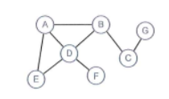
Questions
If the algorithm is altered to output the current vertex, what is the sequence of letters that is output for the graph?
What would be the output for the graph below using the same algorithm
AEDBFCG

Slide 18
Key concept
Depth-first search (DFS)
Traverses the graph, starting at the root vertex, visiting each vertex and exploring each branch as far as possible before backtracking.
Depth- first search on a graph
Depth-first searches are used for pathfinding algorithms, operating system instruction scheduling, the order of formula recalculation in a spreadsheet, linkers and maze solution algorithms.
DFS in simple-structured English
Set a root vertex as the current vertex.
If the vertex has an edge that has not been visited.
  Push the linked vertex to the stack.
  Repeat from step 2 until all edges have been visited.
Add the current vertex to the list of visited vertices.
Pop the stack and set the item removed as the current vertex.
Repeat from step 2 until there are no vertices to visit.
Output all the visited vertices.
The graph on the left shows the order the nodes would be visited using the DFS traversal.

Slide 19
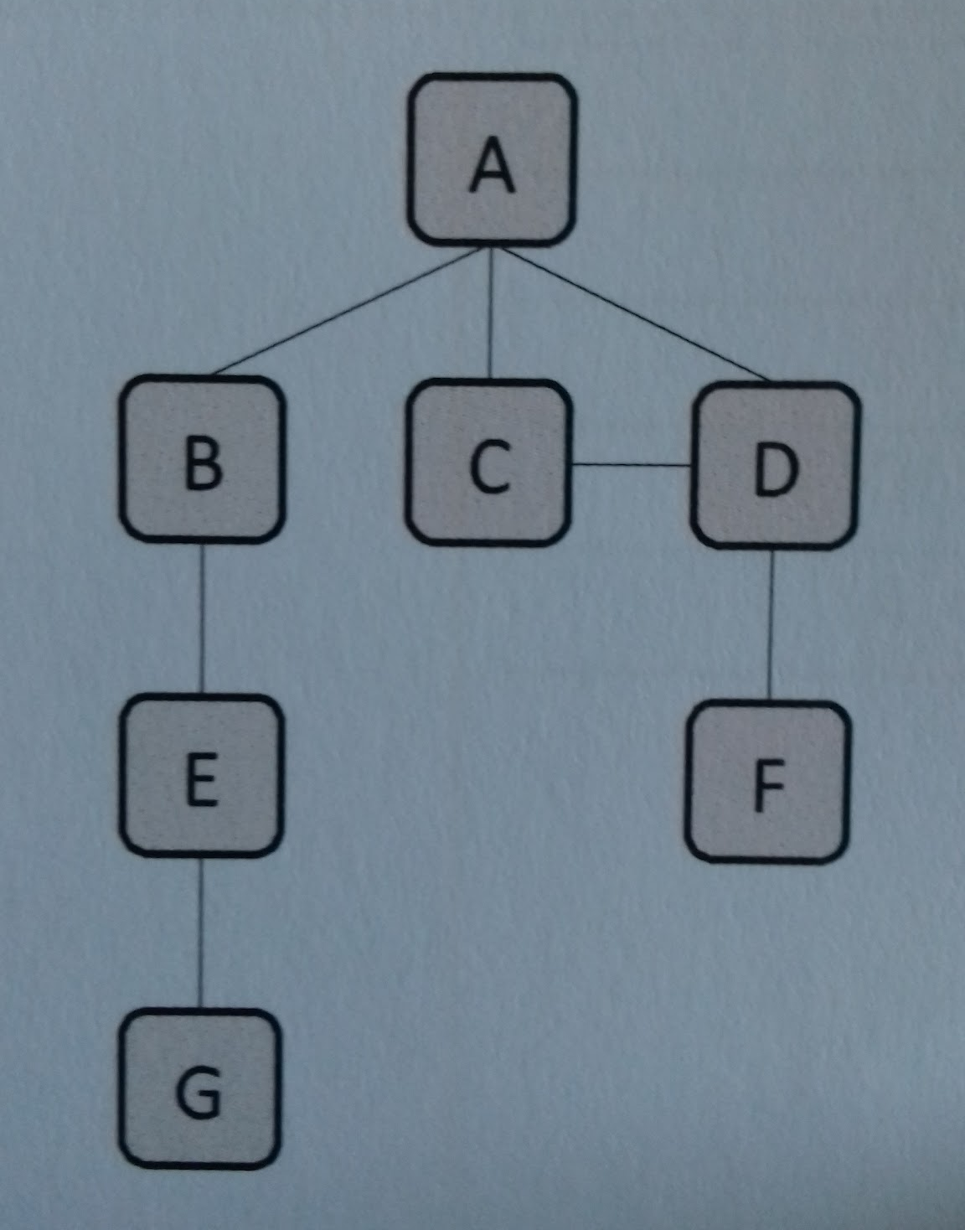
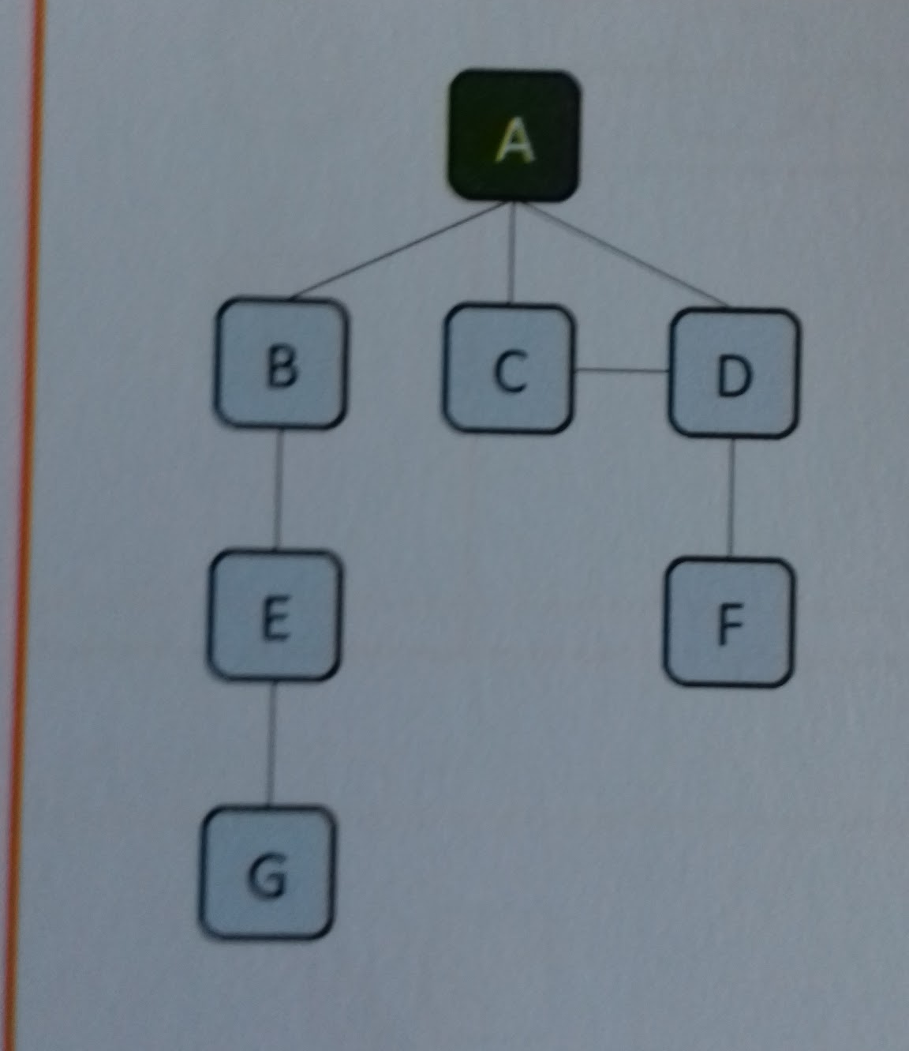
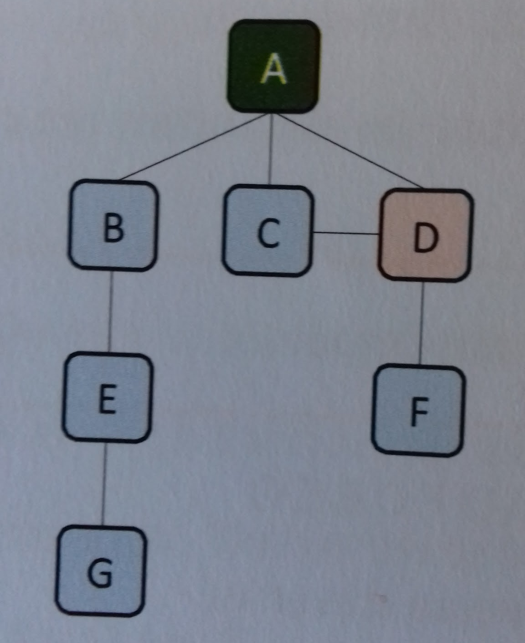
Example three
 | Graph | Stack | Visited
Step 1 | Start at a root vertex. Add A to the list of visited vertices.
 |  |  | A
 | Graph | Stack | Visited
Step 2 | Push D
 |  |  | A
→ | D

Slide 20
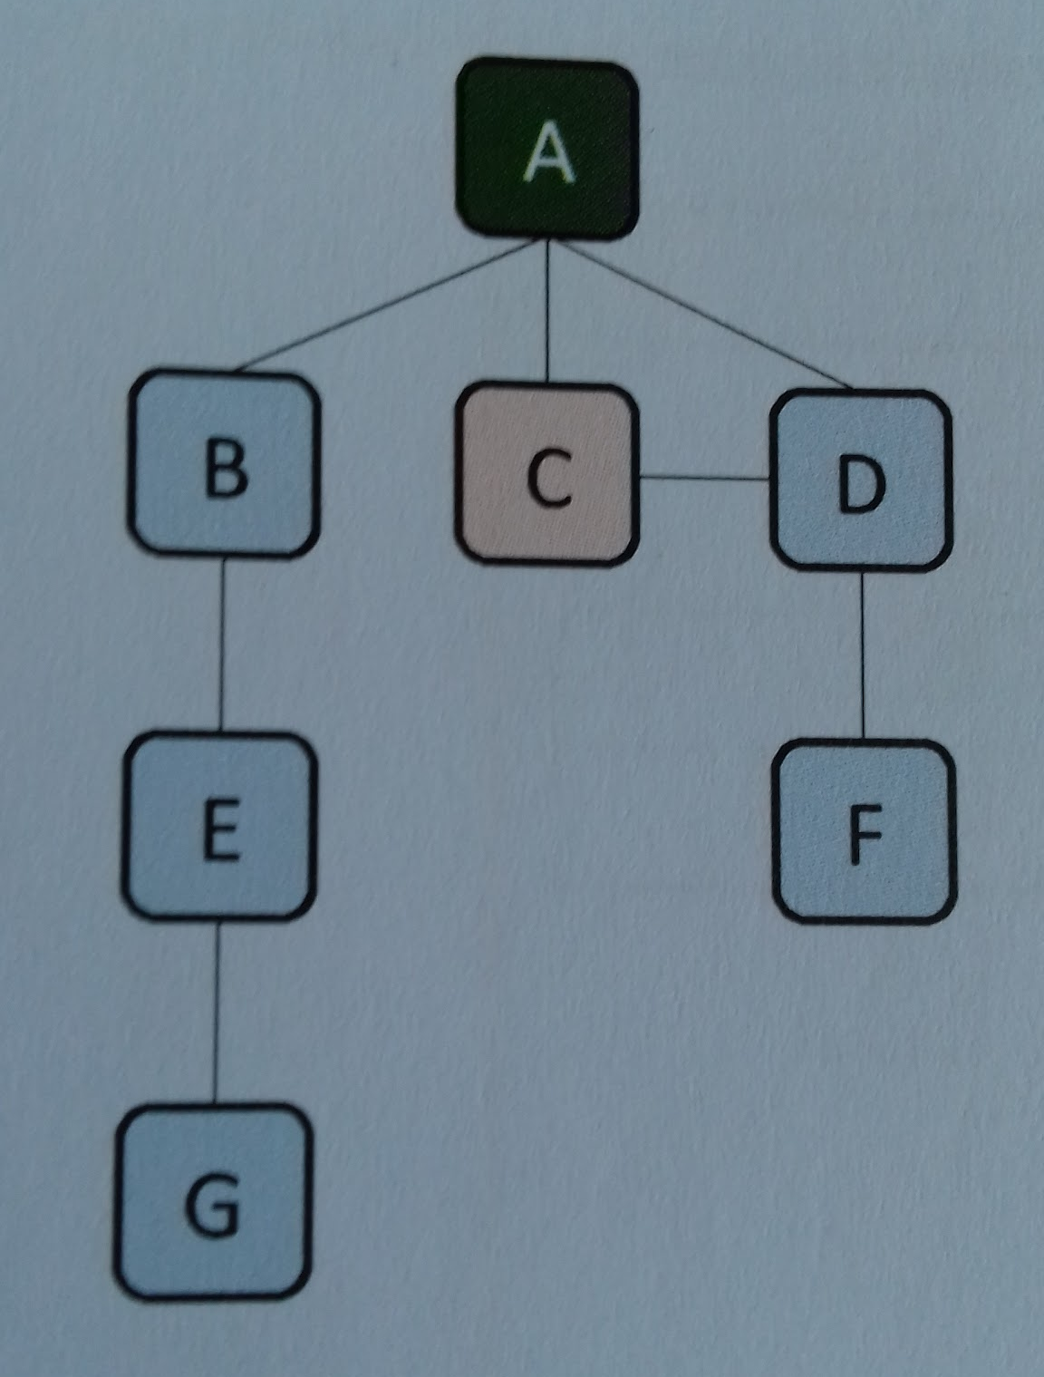
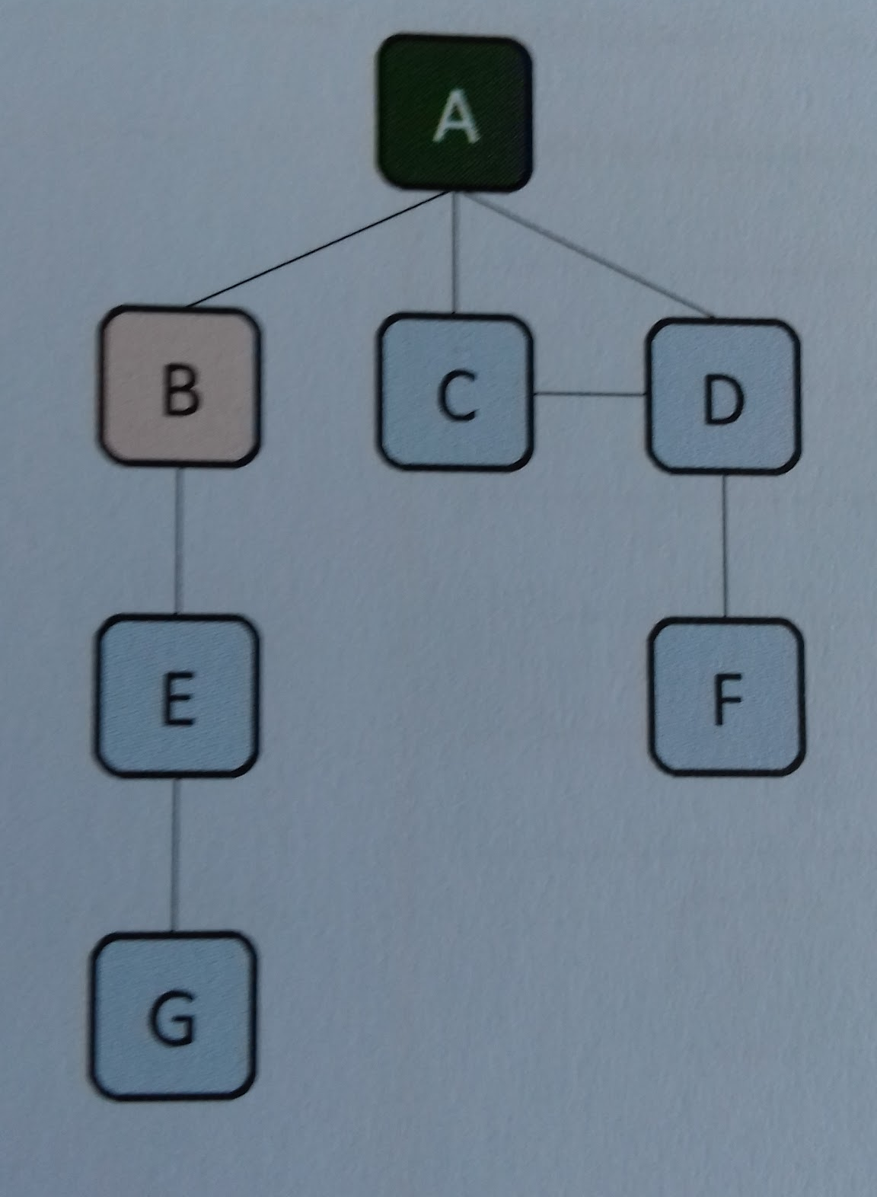
Example three -
 | Graph | Stack | Visited
Step 3 | .Push C
 |  |  | A
 | C
 | D
 | Graph | Stack | Visited
Step 4 | Push B
 |  |  | A
 | B
 | C
 | C

Slide 21
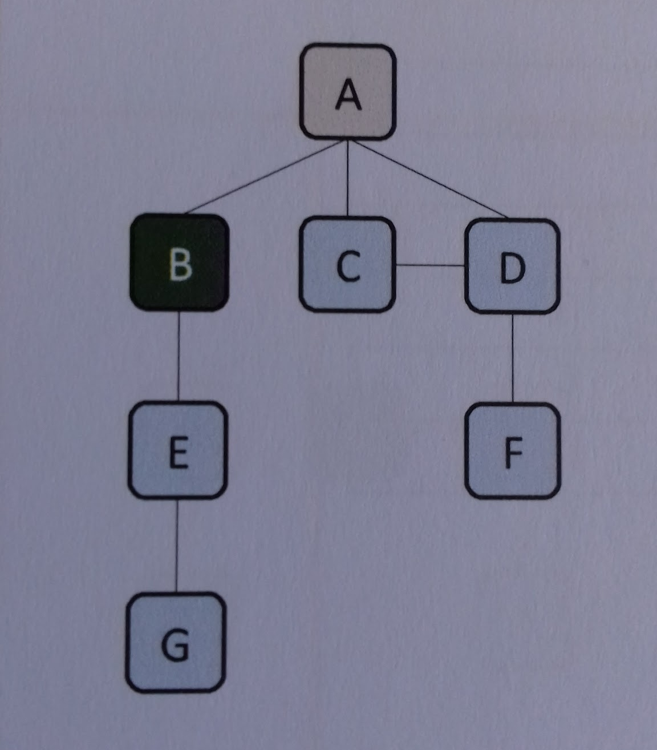
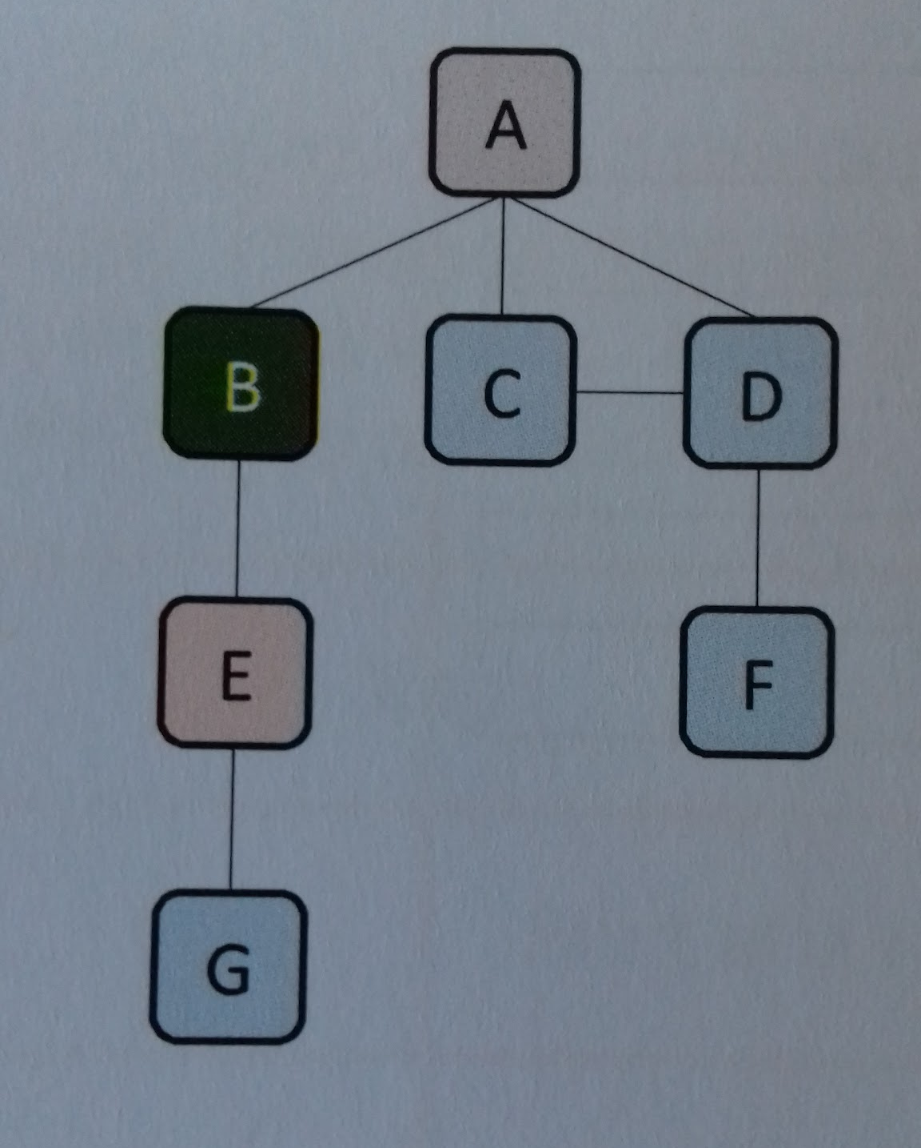
Example three
 | Graph | Stack | Visited
Step 5 | .All edges visited considered. Pop the stack. Set B to be the current vertex. Add B to the list of visited vertices.
 |  |  | A B
 | C
 | D
 | Graph | Stack | Visited
Step 6 | Push E
 |  |  | A B
 | E
 | C
 | D

Slide 22
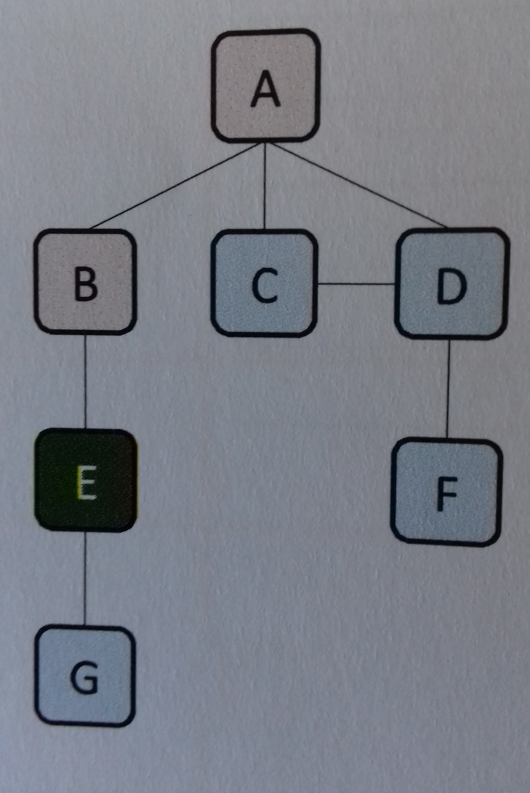
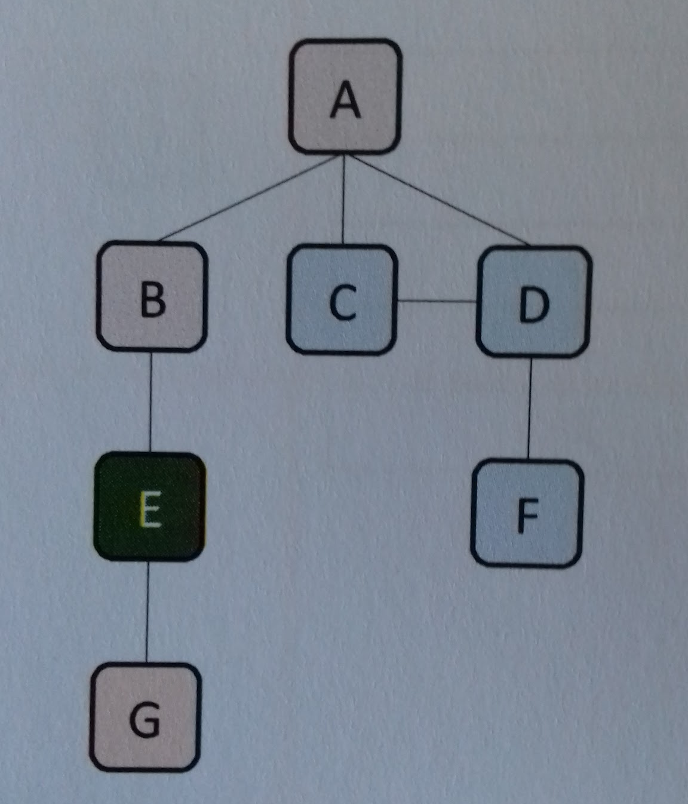
Example three
 | Graph | Stack | Visited
Step 7 | .All edges visited considered. Pop the stack. Set E to be the current vertex. Add E to the list of visited vertices.
 |  |  | A B E
 | C
 | D
 | Graph | Stack | Visited
Step 8 | Push G
 |  |  | A B E
 | G
 | C
 | D

Slide 23
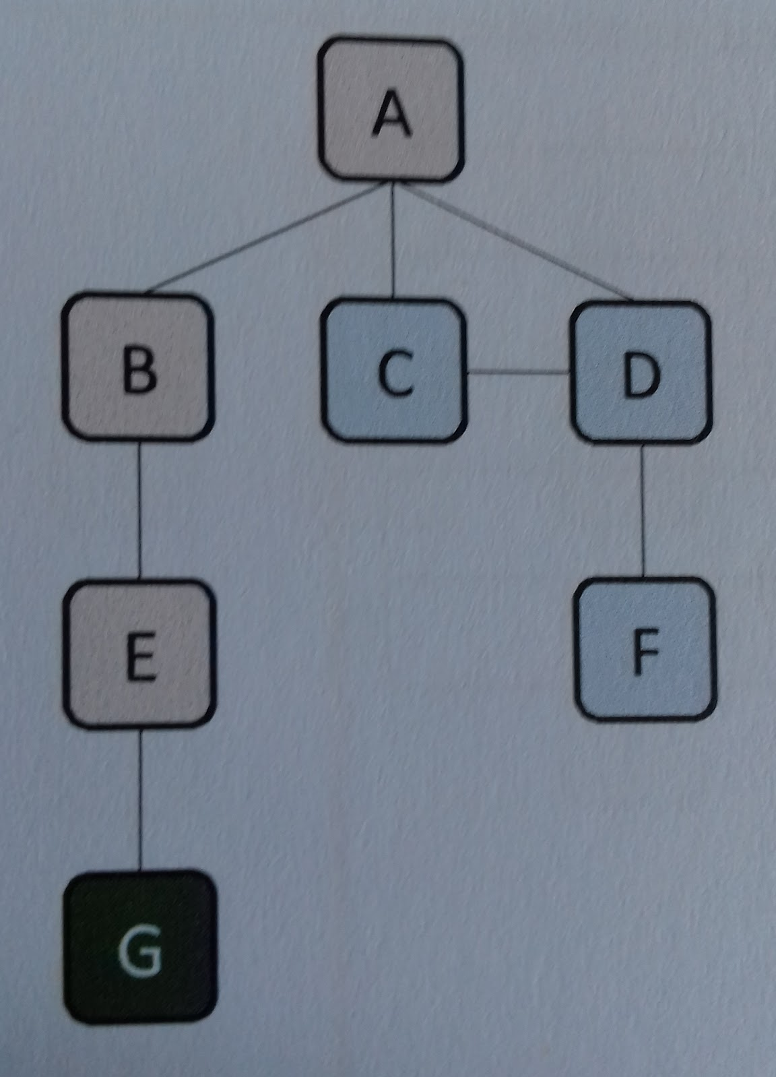
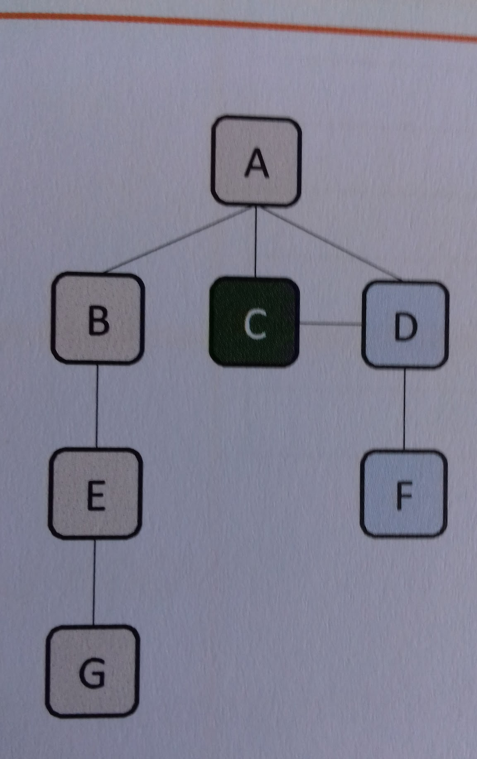
Example three - worked example
 | Graph | Stack | Visited
Step 9 | .All edges visited considered. Pop the stack. Set G to be the current vertex. Add G to the list of visited vertices.
 |  |  | A B E G
 | C
 | D
 | Graph | Stack | Visited
Step 10 | No edges to consider. Pop the stack. Set C to be the current vertex. Add C to the list of visited vertices.
 |  |  | A B E G C
 | D

Slide 24
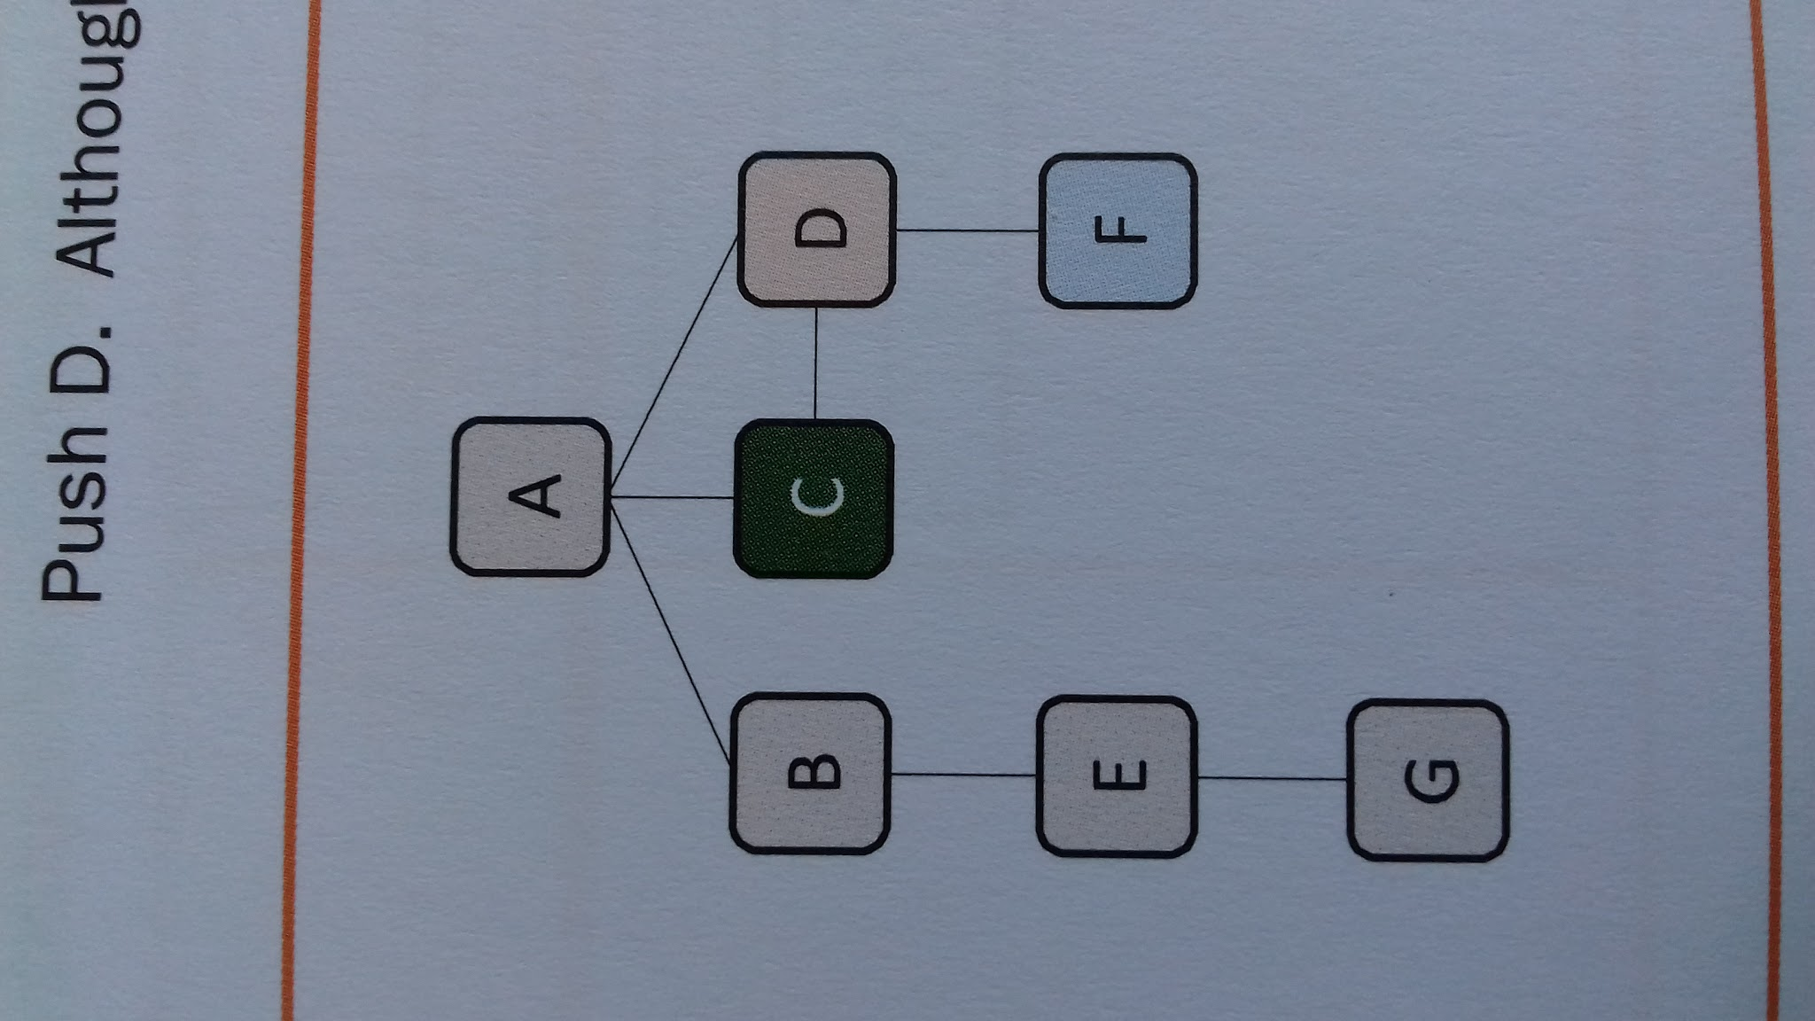
Example three - worked example
 | Graph | Stack | Visited
Step 11 | .Push D. Although D is already on the stack , it has not been visited. This is resolved in the final step.
 |  |  | A B E G C
 | D
 | Graph | Stack | Visited
Step 12 | All edges visited considered. Pop the stack. Set D to be the current vertex. Add D to the list of visited vertices.
 |  |  | A B E G C D

Slide 25
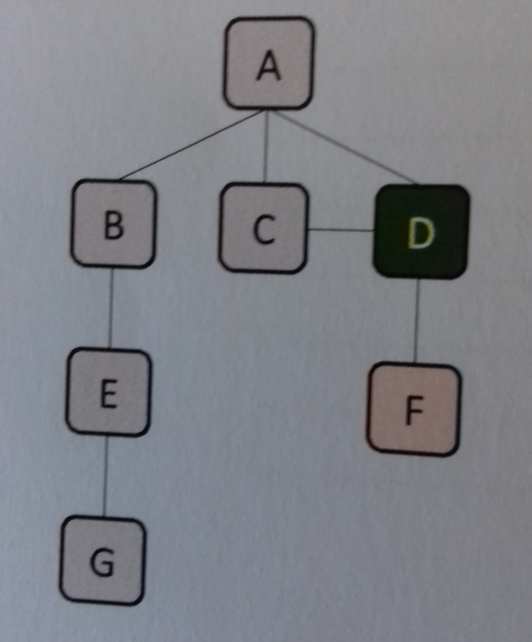
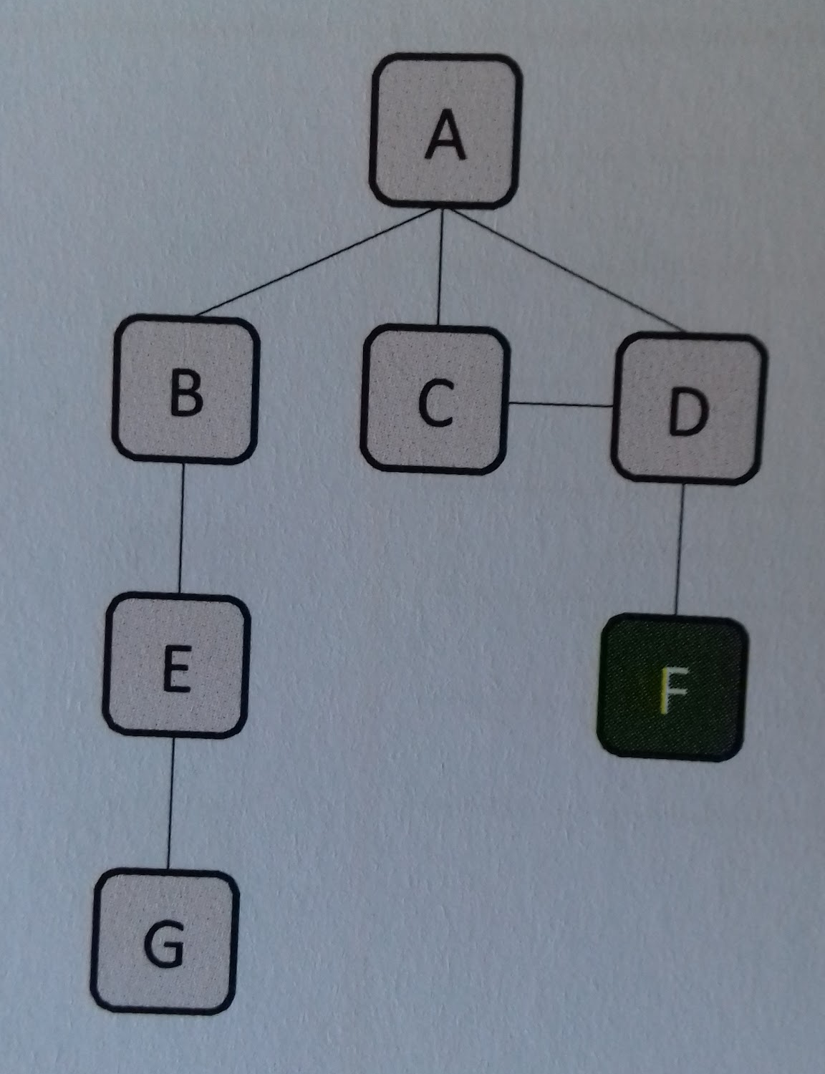
Example three - worked example
 | Graph | Stack | Visited
Step 13 | .Push F.
 |  |  | A B E G C D
 | F
 | Graph | Stack | Visited
Step 14 | All edges visited considered. Pop the stack. Set F to be the current vertex. Add F to the list of visited vertices.
 |  |  | A B E G C D F

Slide 26
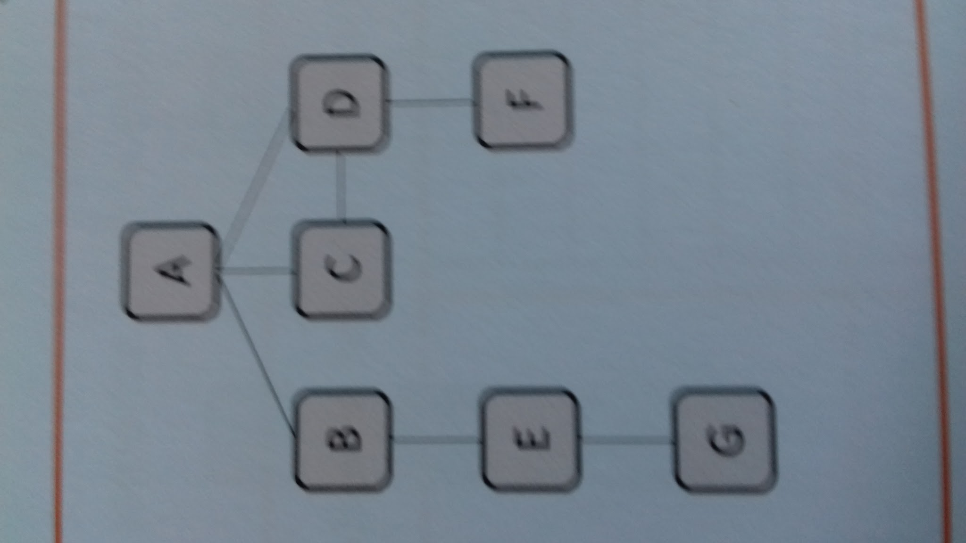
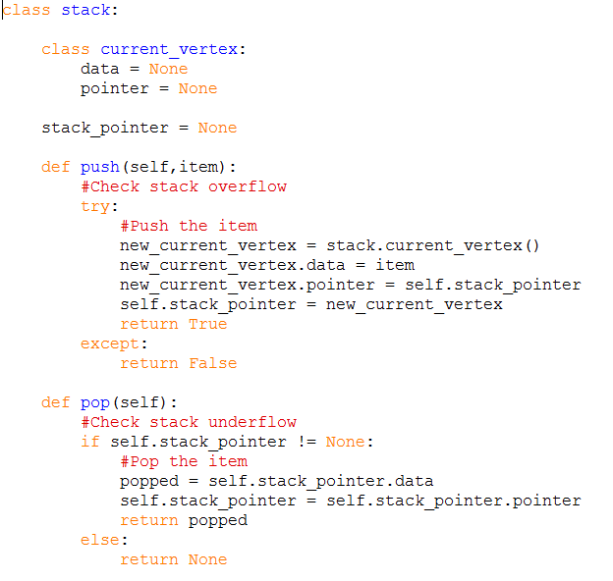
Example three - worked example
 | Graph | Stack | Visited
Step 15 | No edges to consider. Pop the stack. Set D to be the current vertex.D is already in the list of visited vertices. Stack is empty. Algorithm complete..
Code used

Slide 27
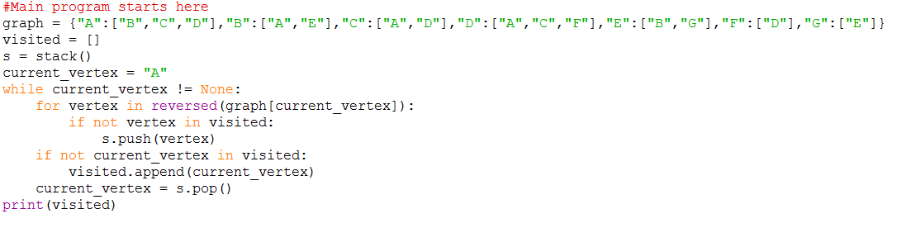

Code used
Practical
Alter the code given to you so that it can search the graph shown below. Write the visited list in the box below.
Answer box

Slide 28
Depth- first search on a graph (recursion)
DFS in simple-structured English
Set a root vertex as the current vertex.
Output the vertex.
Add the current vertex to the list of visited vertices.
If the vertex has an edge that has not been visited
  Follow the edge. The vertex becomes the current vertex.
  Repeat from step 2.
Example four
 | Graph | Stack | Visited
Step 1 | Start at a root vertex. Push A to the stack and list of visited vertices.
 |  |  | A
 | A

Slide 29
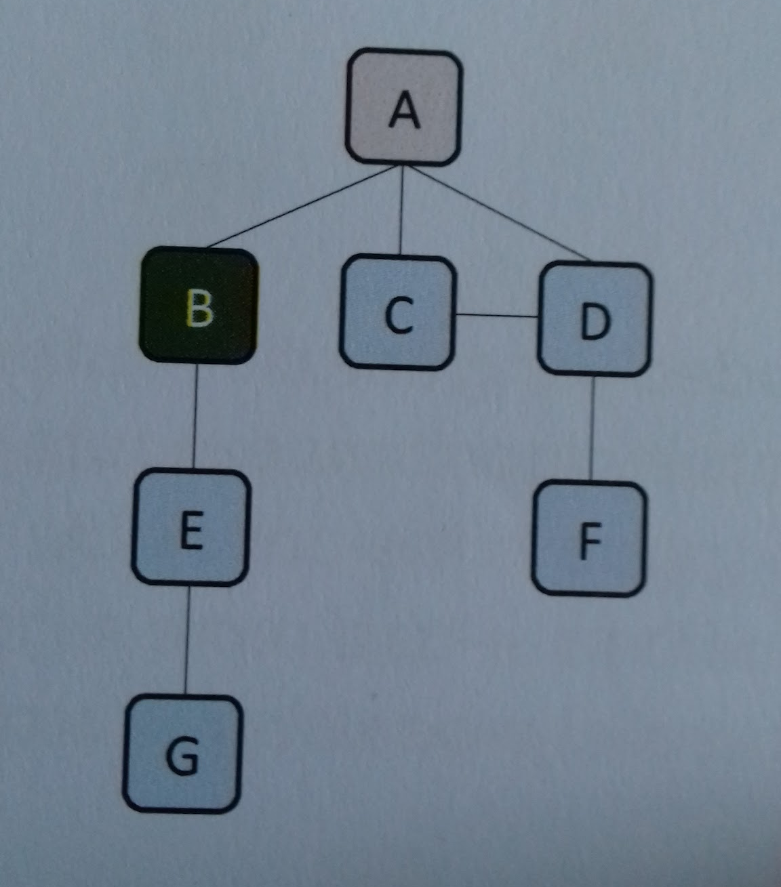
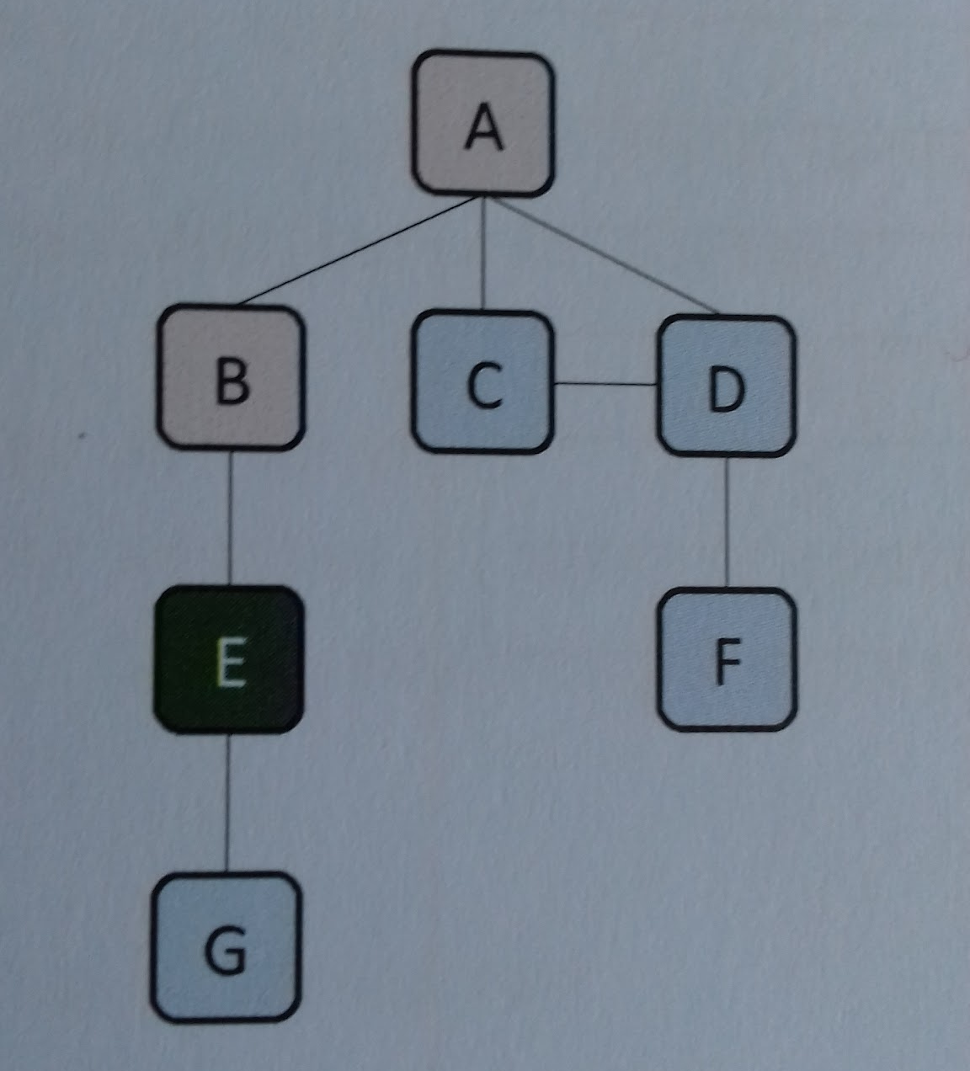
Example four
 | Graph | Stack | Visited
Step 2 | Push B to the stack and list of visited vertices.
 |  |  | A B
 | B
 | A
 | Graph | Stack | Visited
Step 3 | Push E to the stack and list of visited vertices.
 |  |  | A B E
 | E
 | B
 | A

Slide 30
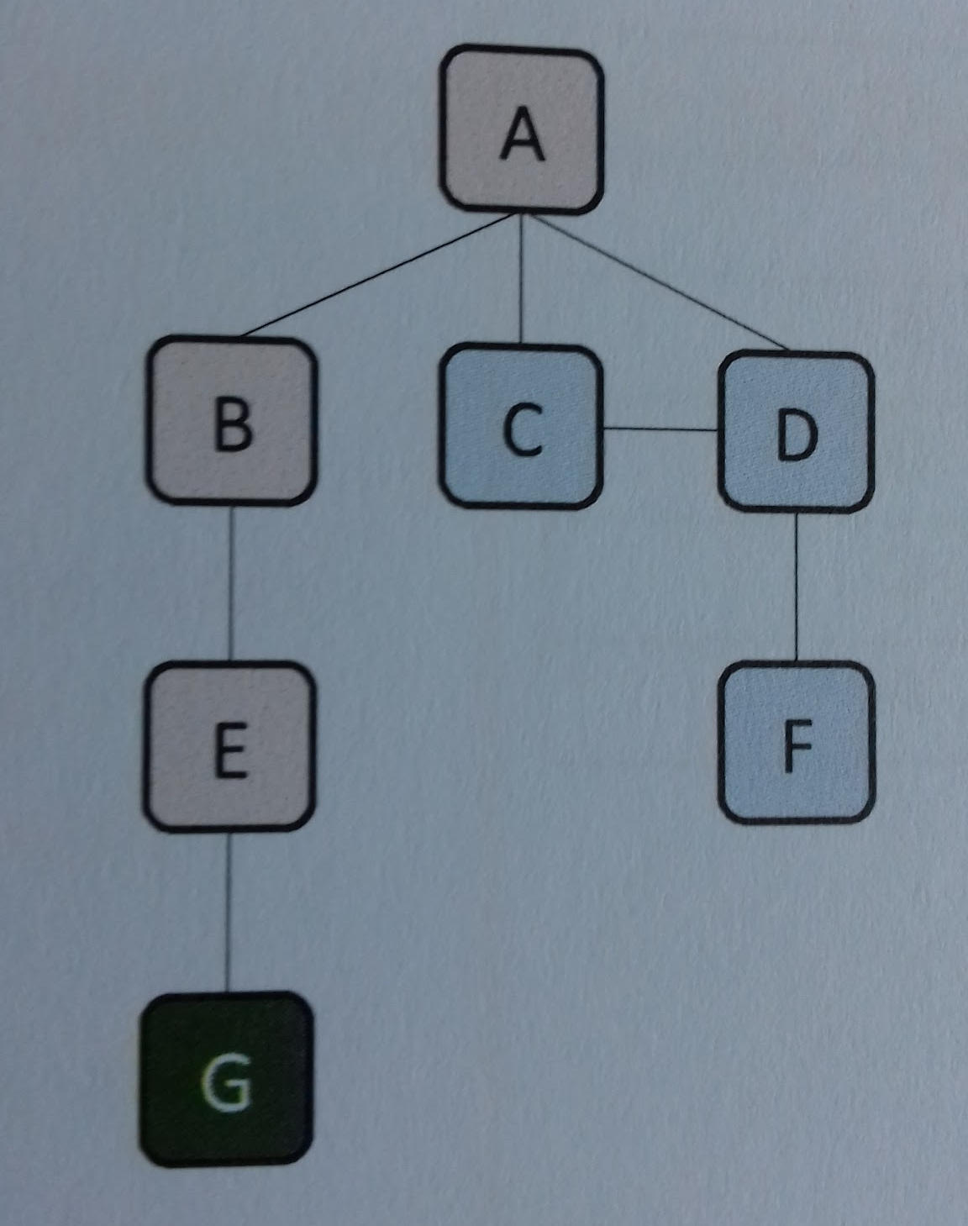
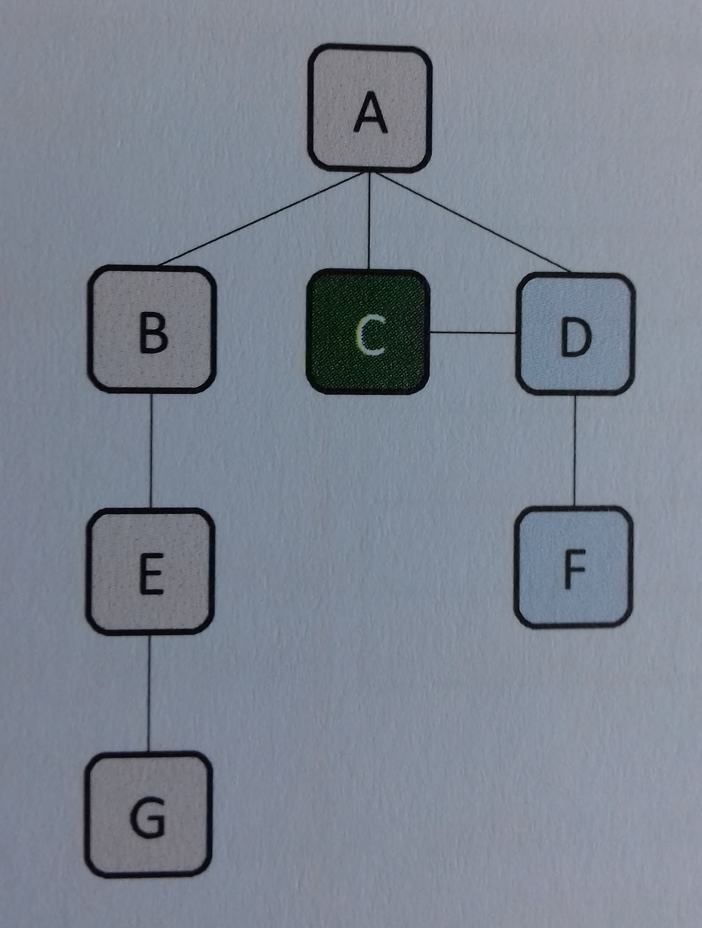
Example four
 | Graph | Stack | Visited
Step 4 | Push G to the stack and list of visited vertices.
 |  |  | A B E G
 | G
 | E
 | B
 | A
 | Graph | Stack | Visited
Step 5 | G has no unvisited edges. Pop the stack. E has no unvisited edges. Pop the stack. B has no unvisited edges. Pop the stack. B has no unvisited edges. Pop the stack. Push C to the stack and list of visited vertices.
 |  |  | A B E G C
 | C
 | A

Slide 31
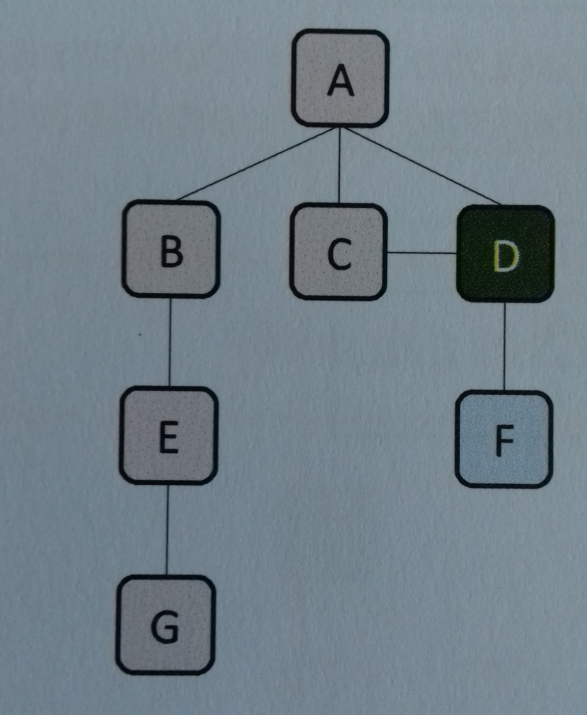
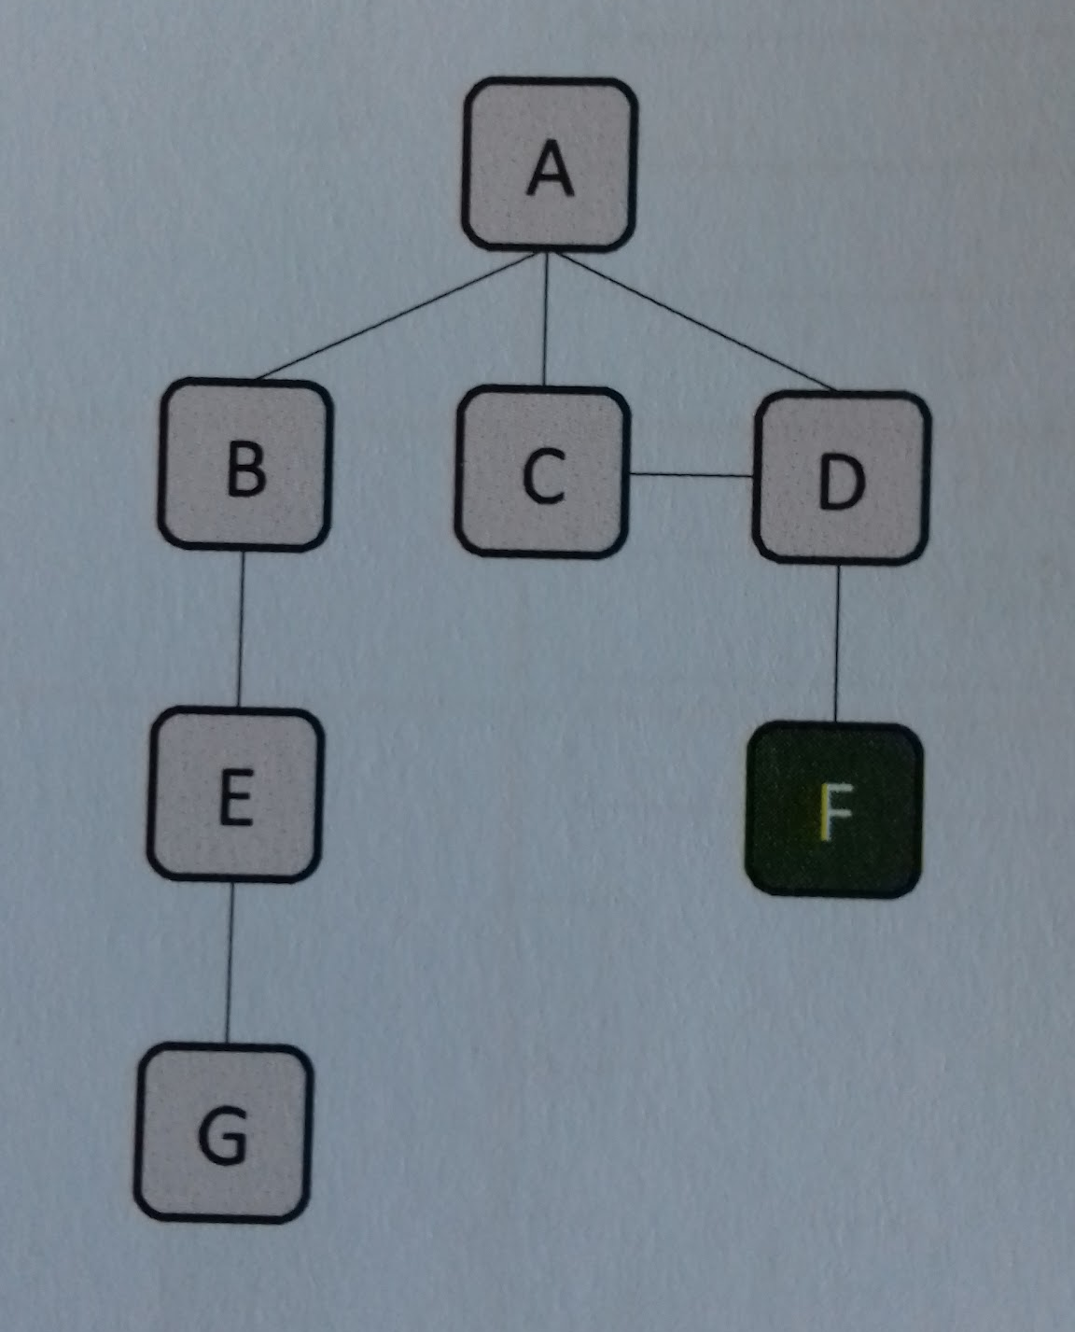
Example four
 | Graph | Stack | Visited
Step 6 | Push D to the stack and list of visited vertices.
 |  |  | A B E G C D
 | D
 | C
 | A
 | Graph | Stack | Visited
Step 7 | Push F to the stack and list of visited vertices.
 |  |  | A B E G C D F
 | F
 | D
 | C
 | A

Slide 32
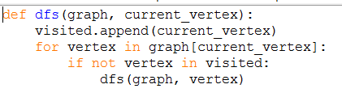
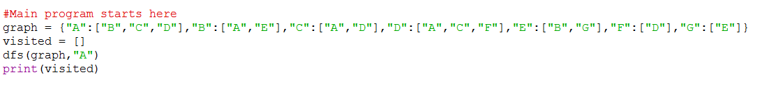

Example four
 | Graph | Stack | Visited
Step 8 | F has no unvisited edges. Pop the stack. D has no unvisited edges. Pop the stack. C has no unvisited edges. Pop the stack. A has no unvisited edges. Pop the stack. Algorithm complete.
 |  |  | A B E G C D F
Code used

Slide 33
Practical
Alter the code given to you so that it can search the graph shown below. Write the visited list in the box below.
Answer box
'A', 'B', 'E', 'F', 'C', 'D', 'G']
Practical
Use the below link to watch the video on Breadth First Search. The code for the example in the video has also been given.
Video link
File name SilconValleyBFS will be posted by your teacher in Teams.
Now try the graph on the right. Write the order in the box below.
Answer box
A['B', 'D', 'E'] 0
B['A', 'C', 'D'] 1
C['B', 'G'] 2
D['A', 'B', 'E', 'F'] 1
E['A', 'D'] 1
F['D'] 2
G['C'] 3

Slide 34
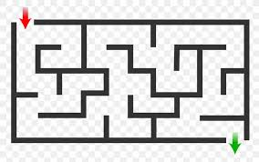
Practical
Use the below link to watch the video on Depth First Search. The code for the example in the video has also been given.
Video link
File name SilconValleyDFS will be posted by your teacher in Teams.
Now try the graph on the right. Write the order in the box below.
Answer box
A,B,C,G,D,E,F
Practical - Maze algorithm
Use the below link to watch the video on a BFS maze solving program.. The code for the example in the video has also been given.
Video link
File name BFSMaze will be posted by your teacher in Teams.
Now try the maze on the right.

Slide 35
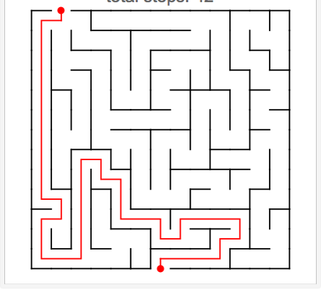
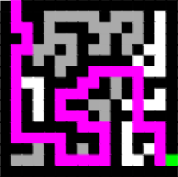
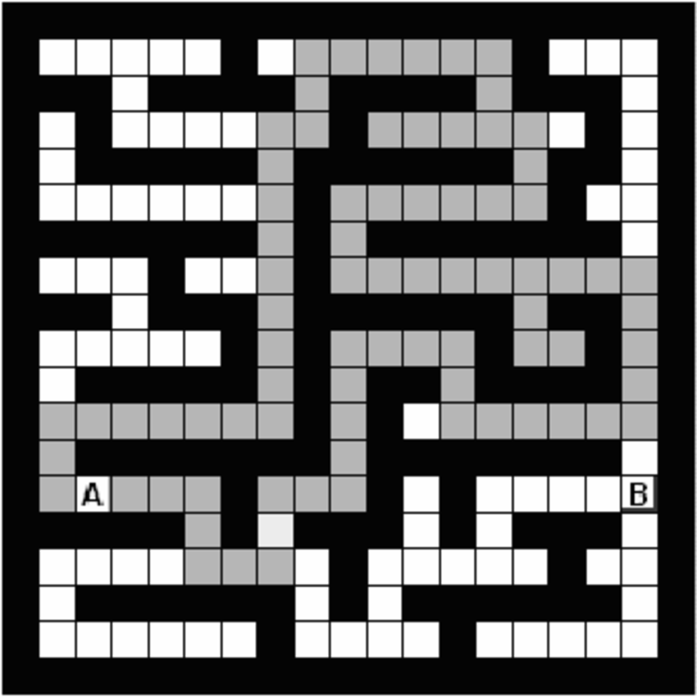
Practical - Maze algorithm
Use the below link to watch the video on a DFS maze solving program.. The code for the example in the video has also been given.
Video link
File name DFSMaze will be posted by your teacher in Teams.
Now try the maze on the right.
Practical - Maze algorithm
Now try these other mazes using the BFS and DFS.

Slide 36
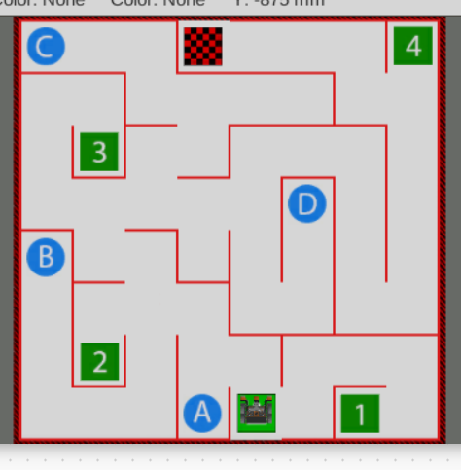
Practical - Robotics Vex Vr
Now click on the below link and select the wall maze playground.
VexCode Vr link
Write DFS and BFS solutions to get the robot to start on the green square and finish on the chequered square at the top of the maze.
Once you have completed this select the dynamic wall maze and attempt to do the samething.

Slide 37

Question - Exam style questions
Stack
Queue
ABCGDEFH
ABDECGFH

Slide 38
Question - Exam style questions

Slide 39




Useful links
Video 1 - Craig N Dave Graph-traversal Youtube video
Video 2 - Computer Science Graph-traversal Youtube video
Playlist 1 - William Fiest Graph Theory Youtube playlist
Website 1 - Isaac Computer Science website - section on Graph traversal
Video 1 | Video 2 | Playlist 1 | Website 1
Action Plan

